Slide 1
“AquaSafe AI”
Smart Water Potability Prediction & Filtration Solutions

Slide 2
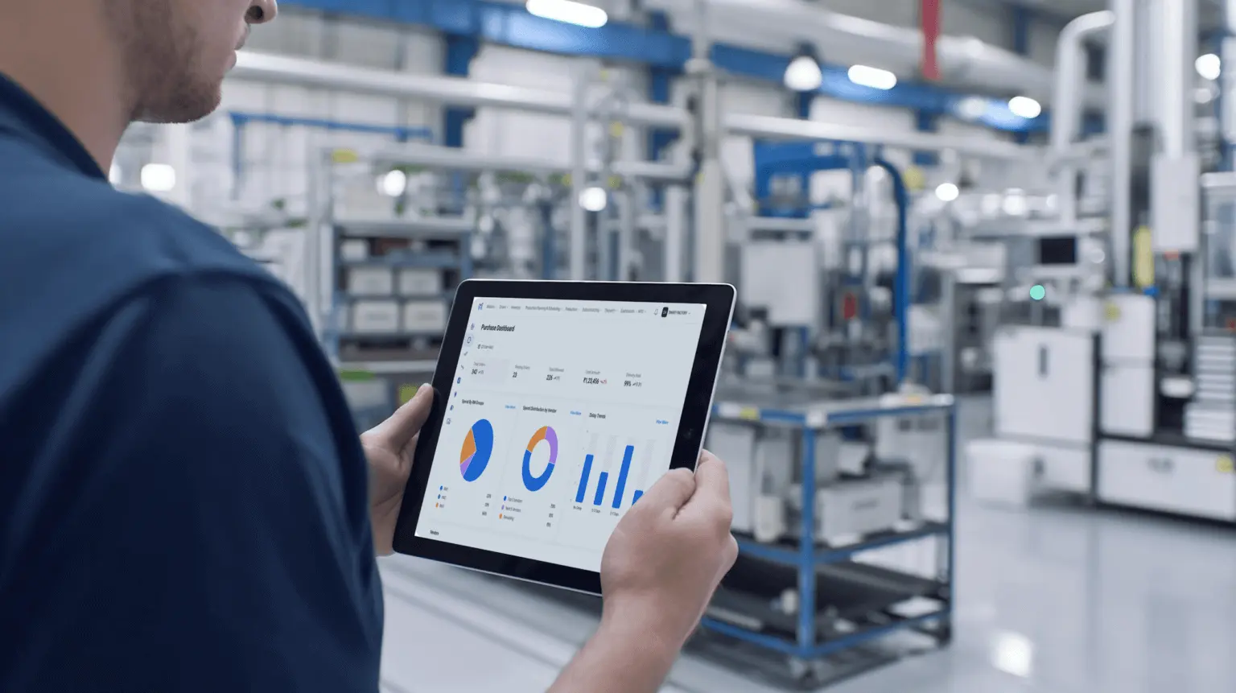
Water Potability Prediction
Project: AquaSafe AI — Smart Water Potability Prediction & Filtration Solutions (Capstone)
Presenter: Shyama Bahuleyan, BIA
Audience: Customer, Manager, Lead, Team Members

Slide 3



About Project
Today I am going to present my capstone project on “Water Potability Prediction for Food Manufacturing using Machine Learning with smart filtration Recommendation Combining data-driven detection, clear visual diagnostics, and targeted treatment recommendations.
SAFE-BY-DESIGN
SUSTAINABLE

Slide 4
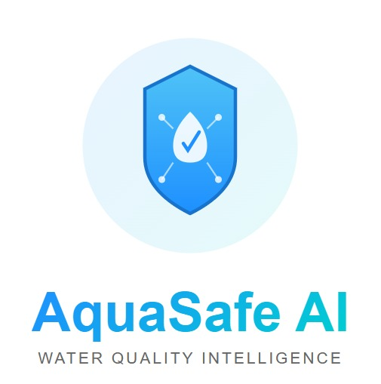
“AquaSafe AI” The App
Is an app for Smart Water Potability Prediction & Filtration Solutions provider for food manufacturing industry— a practical AI-driven system that detects risk, recommends filtration, and reduces downtime.

Slide 5
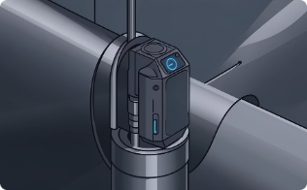
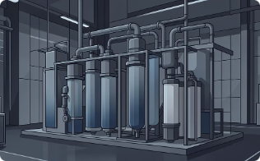

Smart Water Potability Prediction & Filtration Solutions
Project Focus
Water Potability Prediction
Filtration Recommendation
Operational Integration
Use ML to predict potability across plant sources in real time.
Map AI findings to targeted filtration products and maintenance actions.
Deploy operator-friendly dashboard and stakeholder reporting to drive decisions.

Slide 6
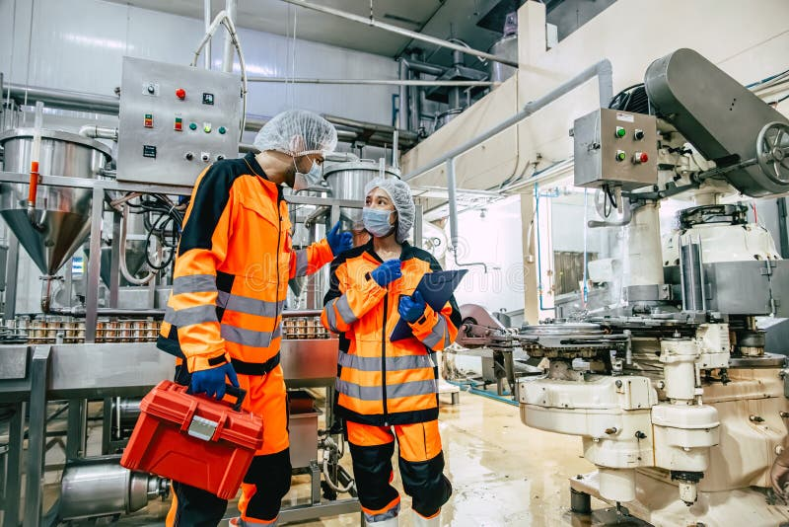
Smart Water Potability Prediction & Filtration Solutions
Problem —Why AquaSafe AI
Mid-sized food plant relied on municipal water that looked clear but caused quality failures: accelerated boiler scaling, off-tastes, rising maintenance costs and a lost export client due to contamination risk.
Root Need
Real-time detection of unsafe water and targeted filtration guidance to prevent product and equipment failures.

Slide 7
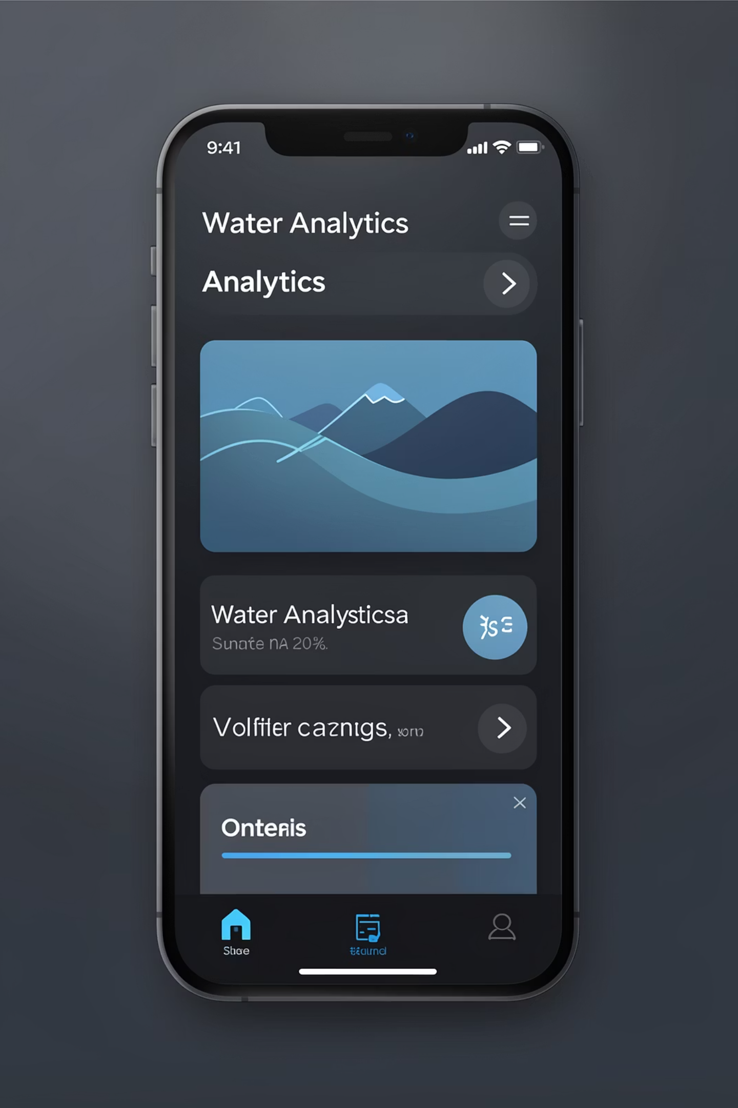
Smart Water Potability Prediction & Filtration Solutions
Solution Concept
AquaSafe AI: an app that ingests sensor and lab data, predicts potability, highlights problematic parameters, and recommends cost-effective filtration or maintenance actions—designed for rapid troubleshooting by plant teams.
Predict
Diagnose
Recommend
ML models score potability per source in seconds.
Pinpoint parameters (e.g., chloramines, turbidity) driving failures.
Match findings to filtration products and operator actions.

Slide 8
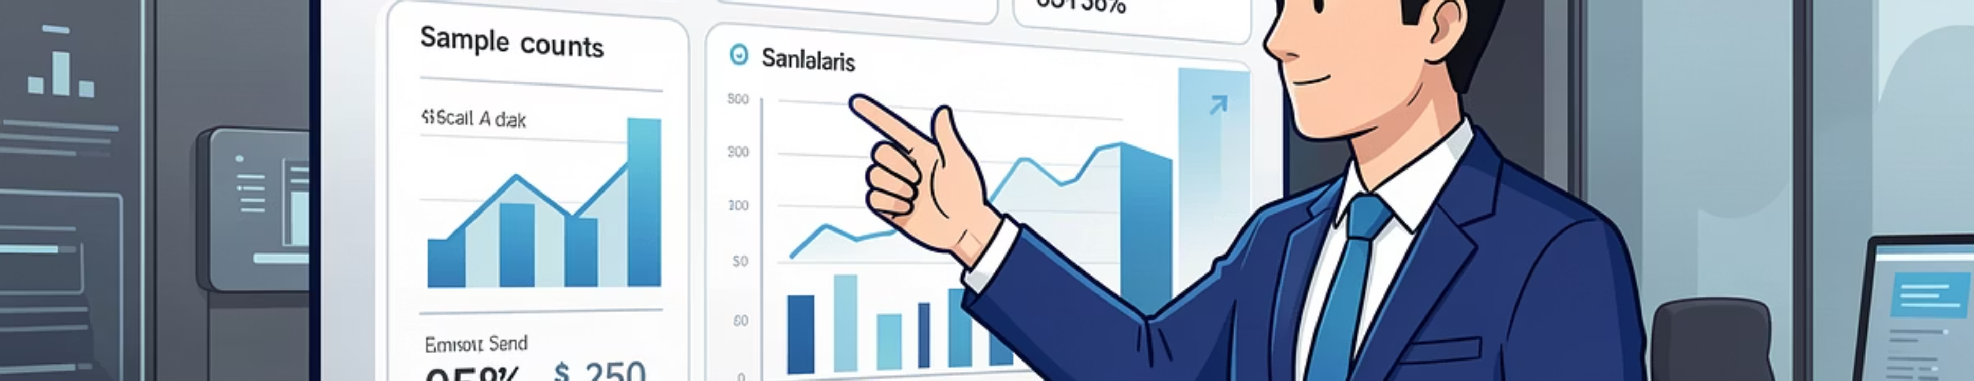


Smart Water Potability Prediction & Filtration Solutions
Business Impact & Dataset
Estimated 40% reduction in routine testing costs and fewer contamination incidents; improved regulatory compliance (FDA/FSSAI).
Dataset
Challenges
3,300 samples from a single food plant, 10 water sources, 9 quality features.
40% missing values, class imbalance (61% unsafe) — addressed during preprocessing.

Slide 9
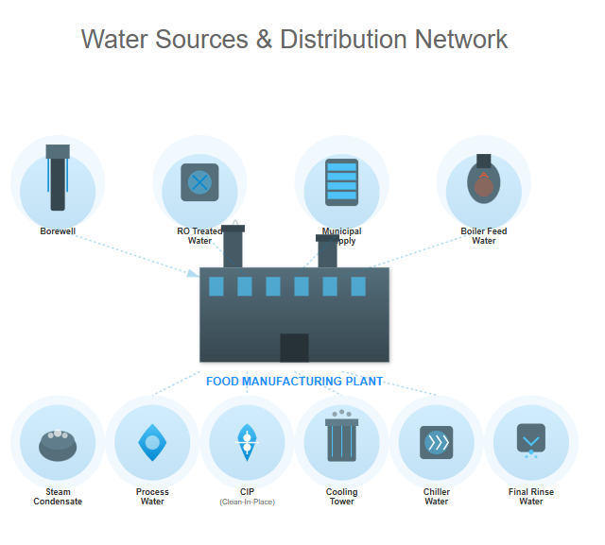
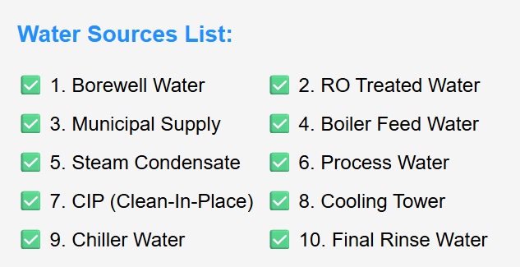
Smart Water Potability Prediction & Filtration Solutions
Plant Water Sources & Risks
Water sources sampled:
Quality varies by source and unit; targeted monitoring needed to prevent cross-contamination and equipment damage.

Slide 10
Smart Water Potability Prediction & Filtration Solutions
Key Features & Preprocessing
🔧 Data Preprocessing Pipeline
Physical: pH, Hardness, Solids, Turbidity, Conductivity
Chemical: Chloramines, Sulfate, Total Organic Carbon, Trihalomethanes
Preprocessing: mean imputation, StandardScaler, Labe lEncoder for sources, SMOTE (k=2) to rebalance
Missing Value Imputation
→ SimpleImputer with mean strategy
Feature Encoding
→ LabelEncoder for water source categories
Feature Scaling
→ StandardScaler for normalization
SMOTE Balancing
→ Synthetic Minority Oversampling (k=2)
Train/Test Split
→ 80/20 split with stratification

Slide 11
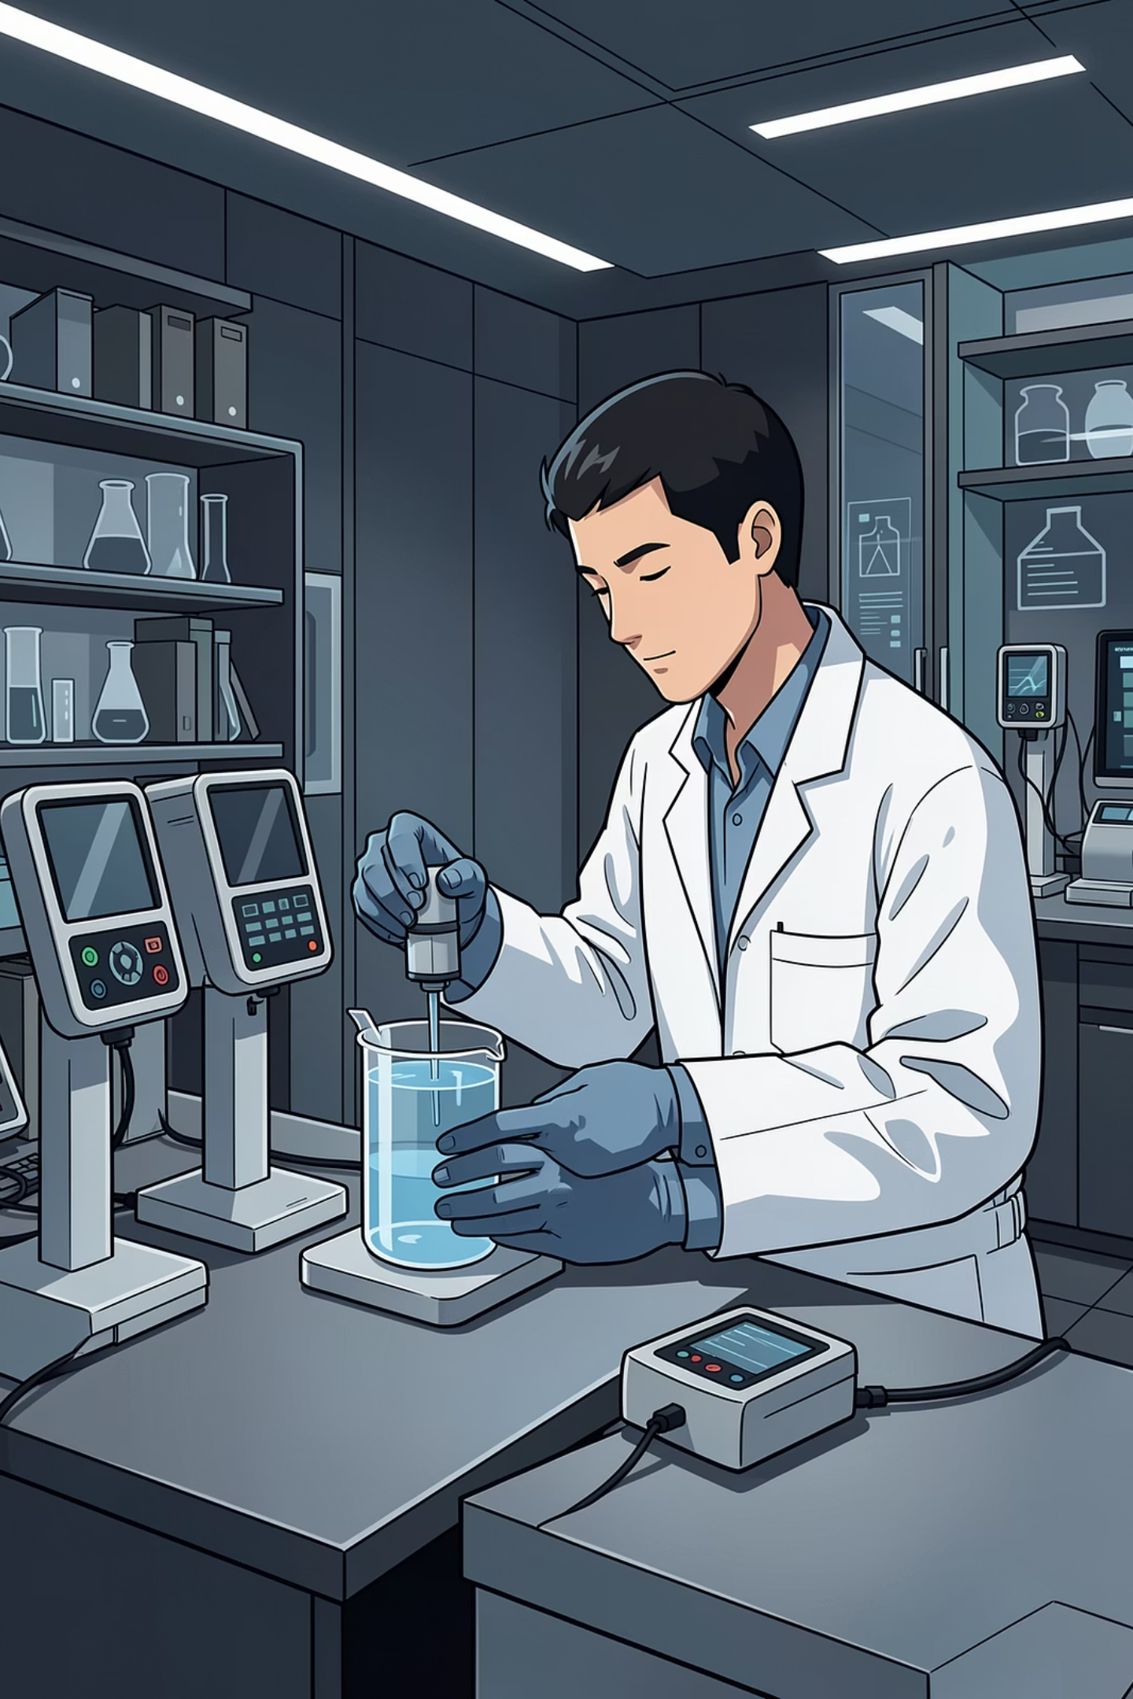
Key Features & Preprocessing
Physical: pH, Hardness, Solids, Turbidity, Conductivity
Chemical: Chloramines, Sulfate, Total Organic Carbon, Trihalomethanes
Preprocessing: mean imputation, StandardScaler, LabelEncoder for sources, SMOTE (k=2) to rebalance
Missing Value Imputation
→ SimpleImputer with mean strategy
Feature Encoding
→ LabelEncoder for water source categories
Feature Scaling
→ StandardScaler for normalization
SMOTE Balancing
→ Synthetic Minority Oversampling (k=2)
Train/Test Split
→ 80/20 split with stratification

Slide 12
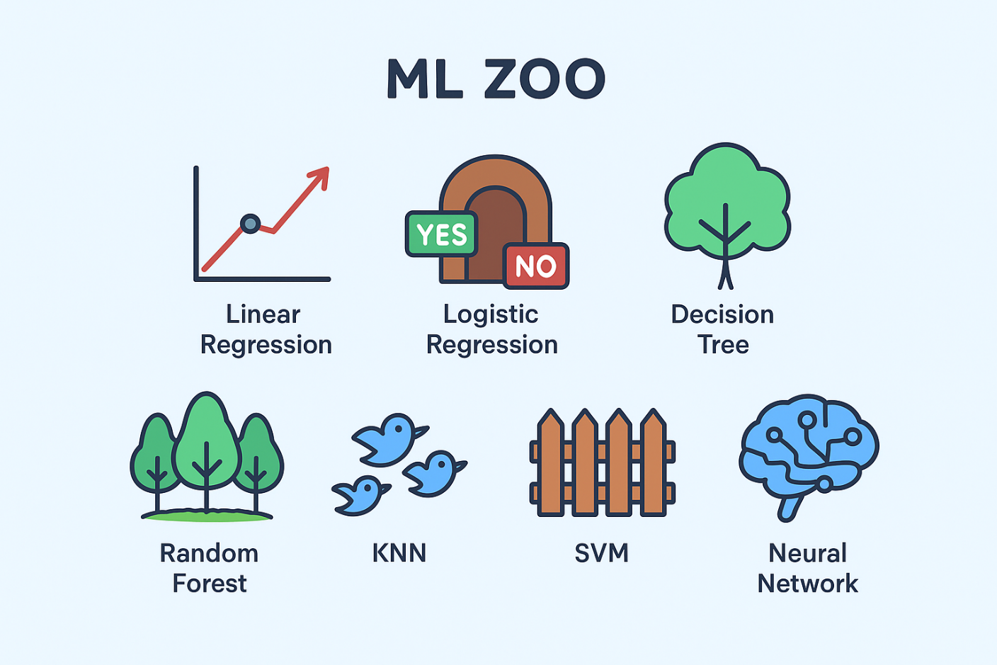
Modeling & Evaluation
Smart Water Potability Prediction & Filtration Solutions
Models Tested (8)
Logistic Regression, Gaussian NB, SVM, KNN, Decision Tree, Random Forest, Gradient Boosting, XGBoost
Pipeline
Impute → Encode → Scale → SMOTE → 80/20 stratified split → Train & validate
Metrics
Accuracy, Precision, Recall, F1, ROC-AUC (target baseline >60% accuracy)

Slide 13
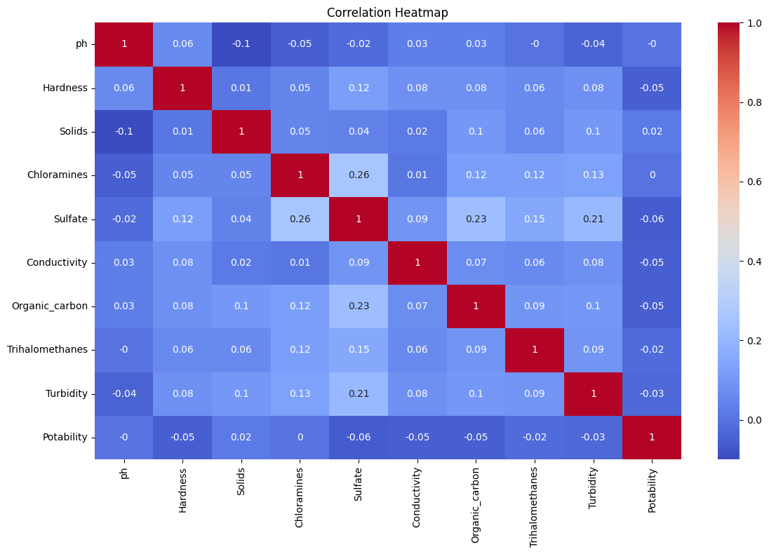
Smart Water Potability Prediction & Filtration Solutions
Feature Engineering — Correlation Matrix
Correlation analysis identified highly related parameters (e.g., Conductivity ↔ Solids)and low-signal features.
We used this to:
Reduce multicollinearity (feature selection & PCA where needed)
Prioritize sensor placement for highest diagnostic value
Inform filtration recommendations tied to specific parameters (e.g., activated carbon for high organic carbon)

Slide 14
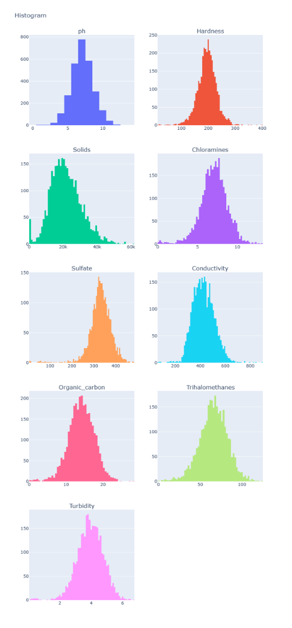
Smart Water Potability Prediction & Filtration Solutions
Data Analysis: Parameter Distributions — Histograms
The histograms show distributional patterns for nine water quality parameters. These visuals highlight central tendencies, multimodal behavior, and tails that indicate high-risk samples.
Key observations
Operational implications
- pH clusters near neutral (6–8).
- Hardness and Solids show wide spread and heavy tails.
- Elevated trihalomethanes and organic carbon flag treatment byproduct risks. . High values are a health risk
- Use RO for high TDS/solids.
- UV or chloramine adjustment for disinfection byproduct control.
- Prioritize high-variance sources for sampling.
They reveal variability in water quality across sources.
They help identify outliers (extremely unsafe samples).
They guide filtration recommendations (e.g., RO for high solids, UV for high chloramines).
They provide visual evidence for stakeholders, making the data easy to interpret.

Slide 15
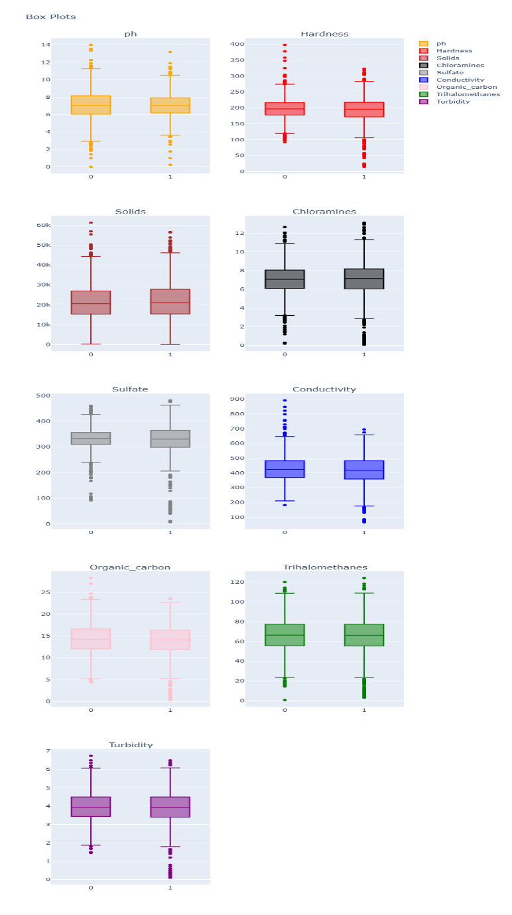
Smart Water Potability Prediction & Filtration Solutions
Data Analysis: Comparing Potable vs Non‑Potable — Box Plots
Box plots compare distributions for potable (1) and non‑potable (0) classes. Medians, IQRs, and outliers clarify which parameters most strongly separate safe from unsafe samples.
Interpreting the plots
Actionable insight
- Higher medians and wider IQRs in non‑potable samples indicate drivers of contamination: Hardness, Solids, Sulfate, and Conductivity commonly exceed safe thresholds
- Use box plot patterns to design tiered treatment: softening + RO for mineral loads; targeted disinfectant control and TOC reduction to limit DBPs.
These box plots compare safe vs unsafe water samples. For most parameters, unsafe water shows higher values and more variability — for example, hardness, solids, and sulfate are much higher in unsafe samples. This visualization makes it easy to see which parameters drive potability and why filtration is needed

Slide 16
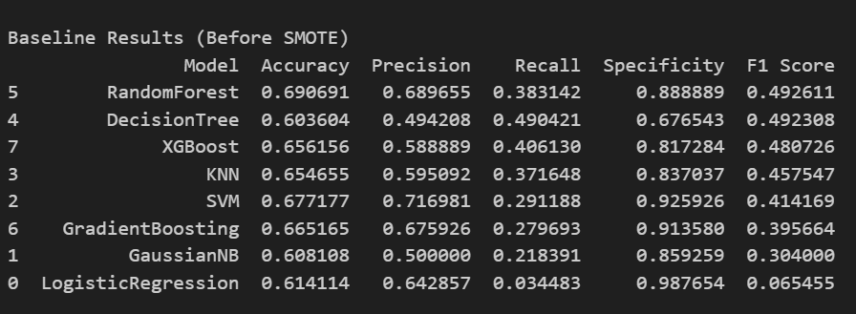
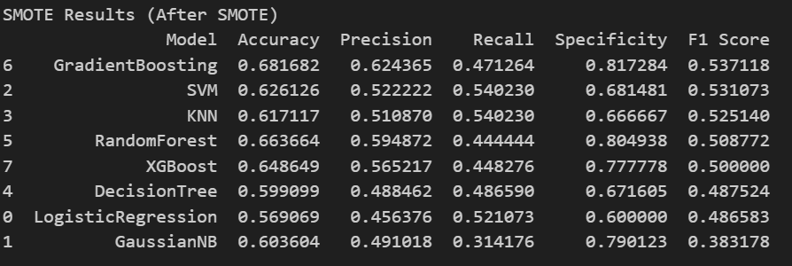
Smart Water Potability Prediction & Filtration Solutions
Before and After Smote-Model

Slide 17
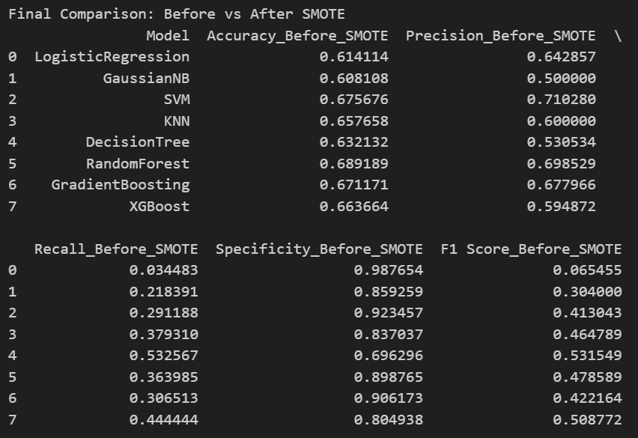
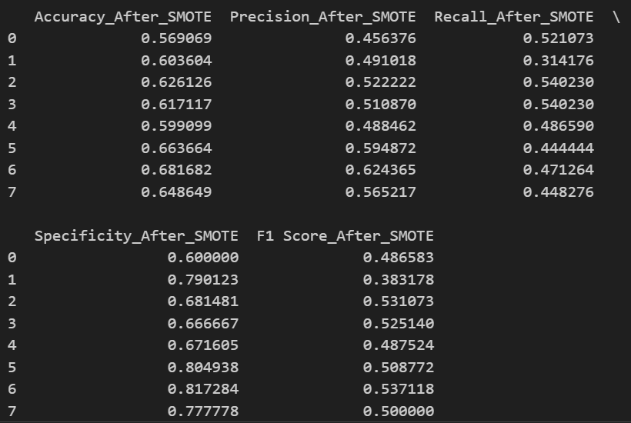
Smart Water Potability Prediction & Filtration Solutions
Before and After Smote Model comparison along with

Slide 18
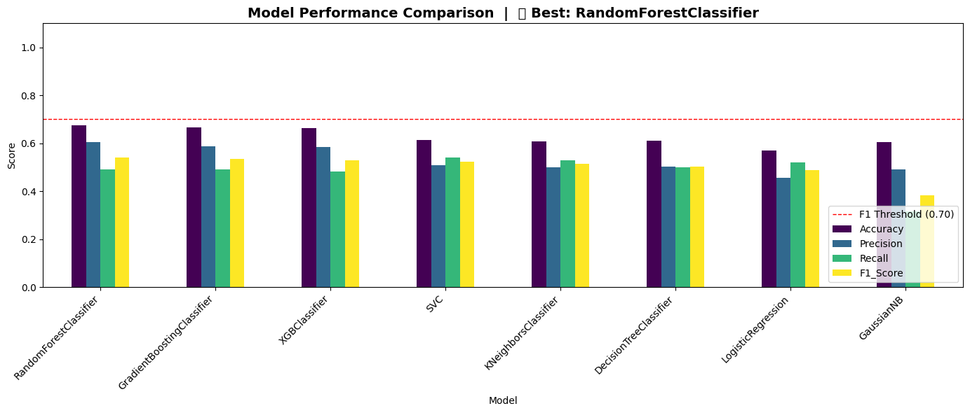
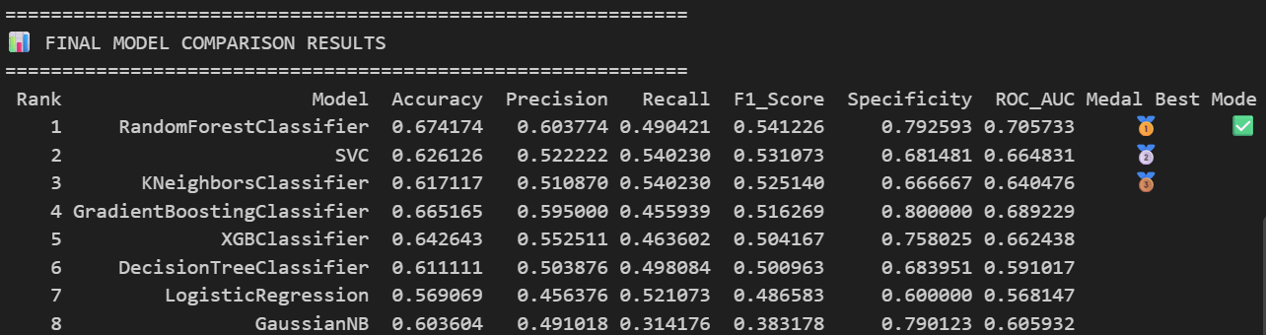
Smart Water Potability Prediction & Filtration Solutions
Best Model- Random Forest

Slide 19
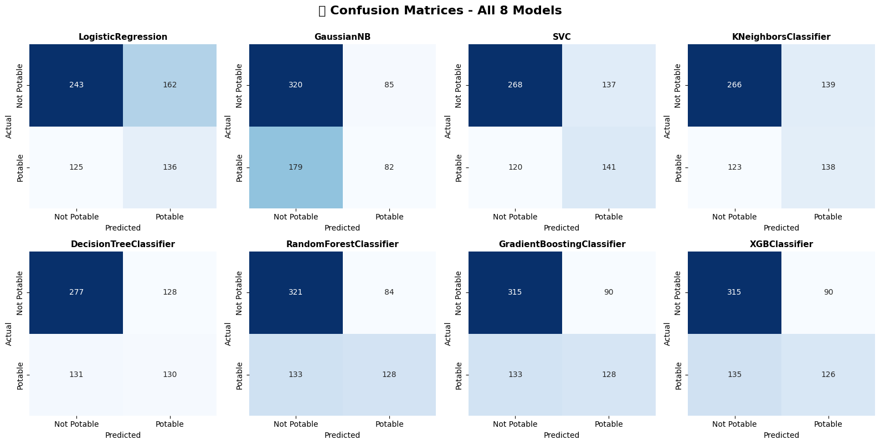
Smart Water Potability Prediction & Filtration Solutions
Confusion Metrics for all the 8 models

Slide 20
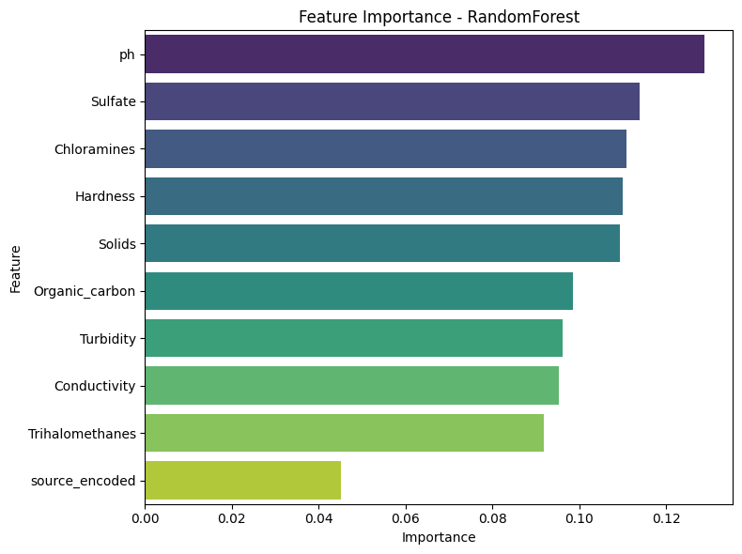
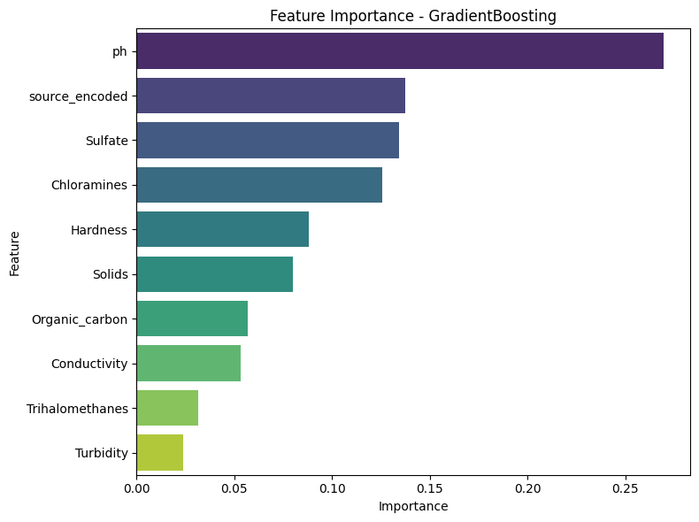
Smart Water Potability Prediction & Filtration Solutions
Feature Importance of Best 4 models

Slide 21
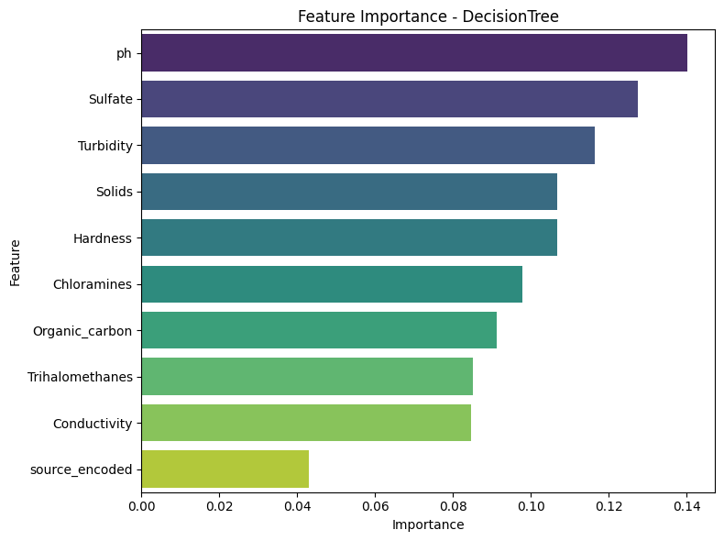
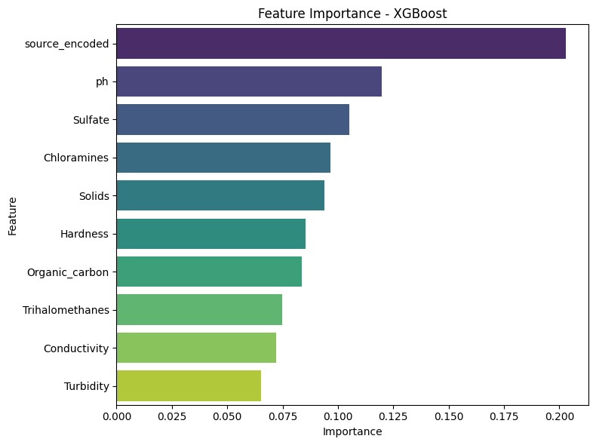
Smart Water Potability Prediction & Filtration Solutions
Feature Importance of Best 4 models

Slide 22
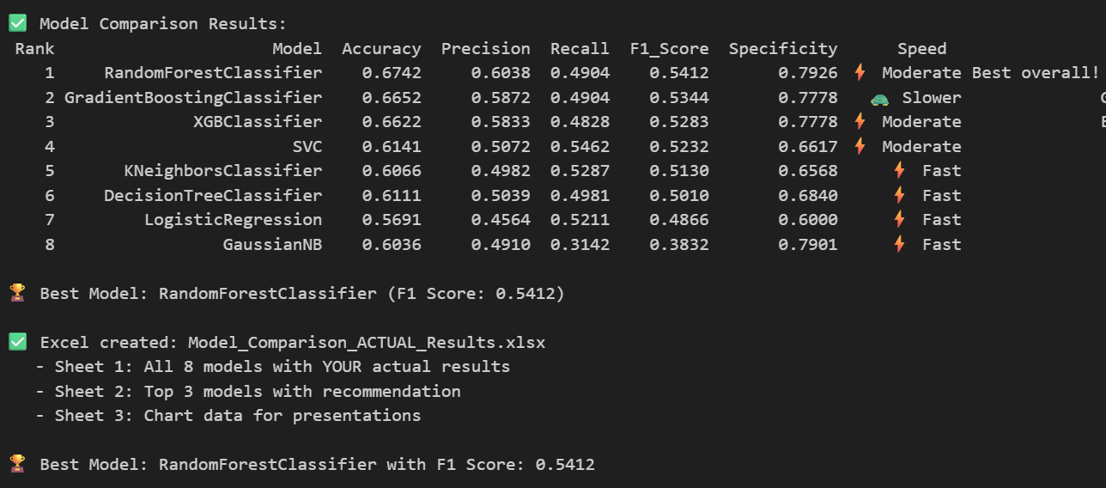
Best Model: RandomForestClassifier (F1 Score: 0.5412)

Slide 23
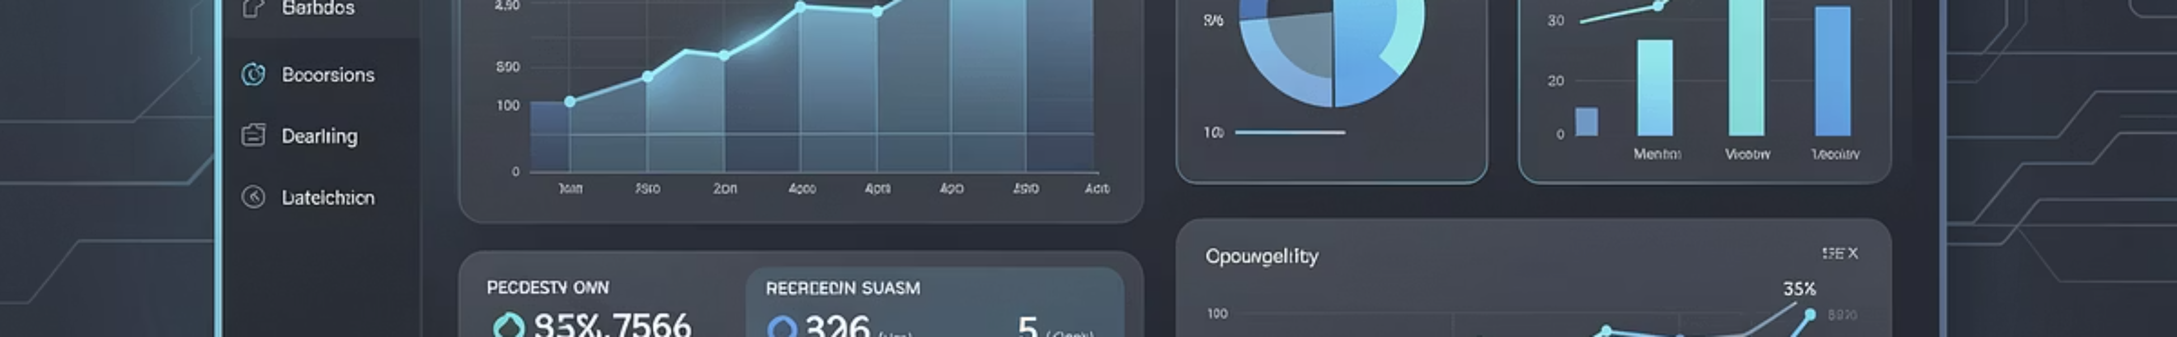

Smart Water Potability Prediction & Filtration Solutions
Model Performance & Top Methods
Random Forest — Best Performer
Gradient Boosting
XGBoost
Accuracy 67.4% · F1 55.1% · ROC‑AUC 65.1% — robust to outliers, handles class imbalance, captures nonlinear interactions.
Accuracy 66.5% · F1 53.4% · ROC‑AUC 63.4% — strong generalization after tuning.
Accuracy 65.3% · F1 53.0% · ROC‑AUC 62.6% — fast training, interpretable feature importance.
Practical takeaway: Random Forest performs best due to:
• Handles imbalanced data well
• Robust to outliers
• Captures complex feature interactions.

Slide 24
Smart Water Potability Prediction & Filtration Solutions
Top Predictive Features (by importance)
pH — 18.2%
Hardness — 15.7%
Total Solids (TDS) — 14.3%
Primary indicator of acidity/alkalinity; large impact on microbial survival and chemical speciation.
Calcium & magnesium levels influence scaling and suitability for certain processes.
Indicator of dissolved salts; affects conductivity and osmotic stress for organisms.
Sulfate — 12.1%
Conductivity — 11.8%
Proxy for ionic strength; fast on-line measurement useful for continuous monitoring.
Salt concentration affecting corrosion and treatment selection.

Slide 25
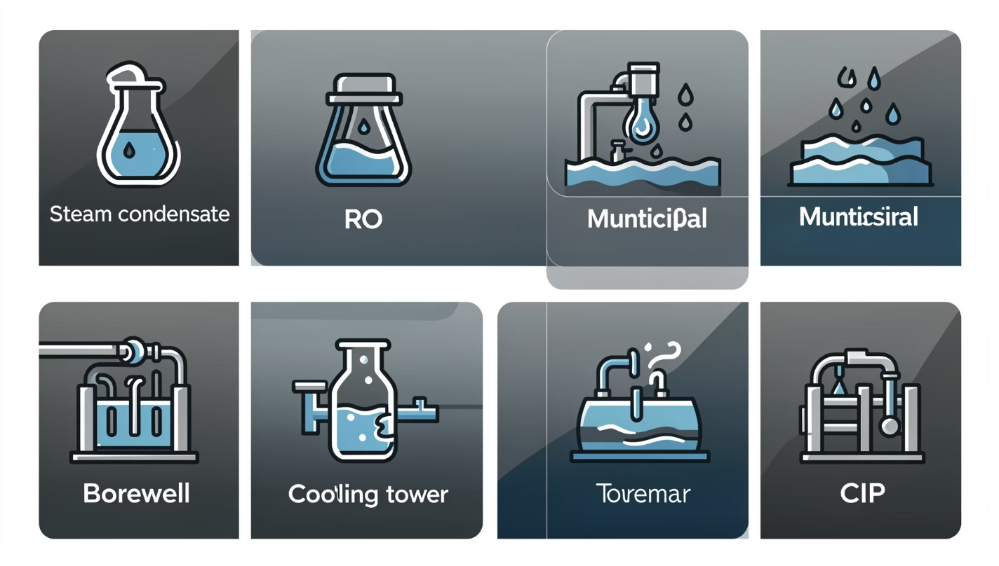

Source Safety Summary
Smart Water Potability Prediction & Filtration Solutions
Safe (>50% potable)
Steam condensate — 95%
RO treated water — 92%
Boiler feed water — 88%
Final rinse water — 85% (critical)
Municipal supply — 72%
Unsafe (<50% potable)
Chiller water — 38% (risk of biofouling)
Cooling tower — 35% (microbial & scaling risk)
Process water — 29% (variable quality)
Borewell — 25% (geogenic contaminants)
CIP water — 18% (high organics, solids)
Estimated annual savings from optimized treatment: $50,000 (reduced downtime, lower chemical use, extended equipment life).

Slide 26
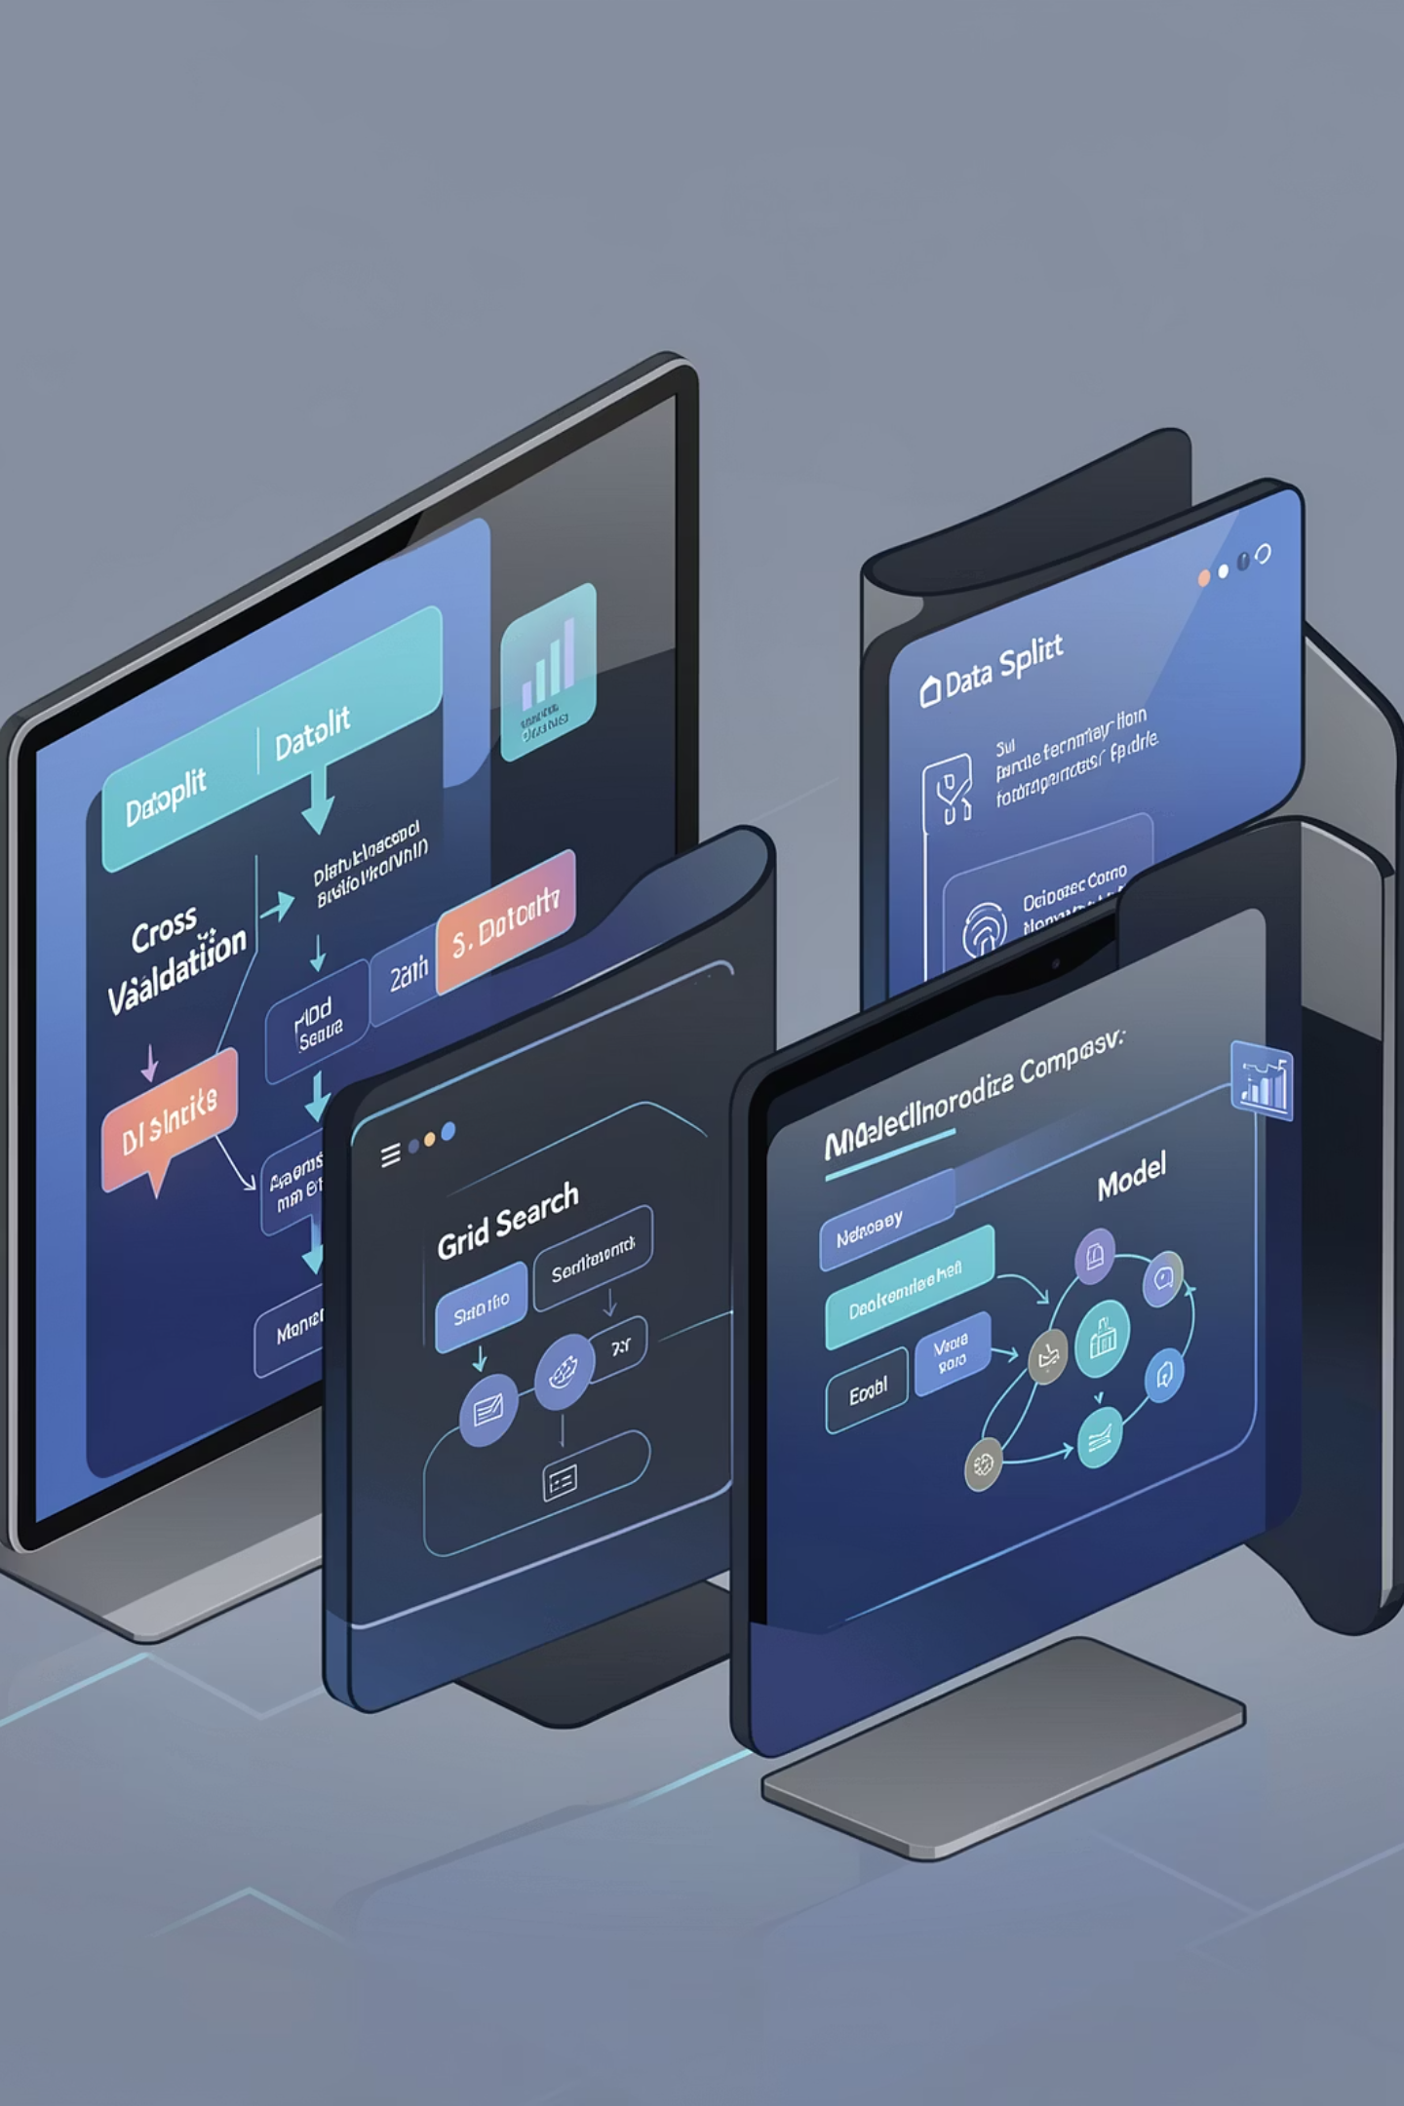
Model Training & Evaluation Pipeline
Smart Water Potability Prediction & Filtration Solutions
Data Preparation
Imputation, scaling, class-balance strategies, feature engineering for water chemistry.
Modeling
Train/test split · Cross‑validation · GridSearchCV across LR, KNN, SVM, trees, ensembles.
Evaluation
Accuracy, Precision, Recall, F1, ROC‑AUC, and Confusion Matrix used to select operational thresholds.
Operationalization
Deploy ensemble scoring with monitoring, drift detection, and periodic retraining.
Deploy ensemble scoring with monitoring, drift detection, and periodic retraining.

Slide 27
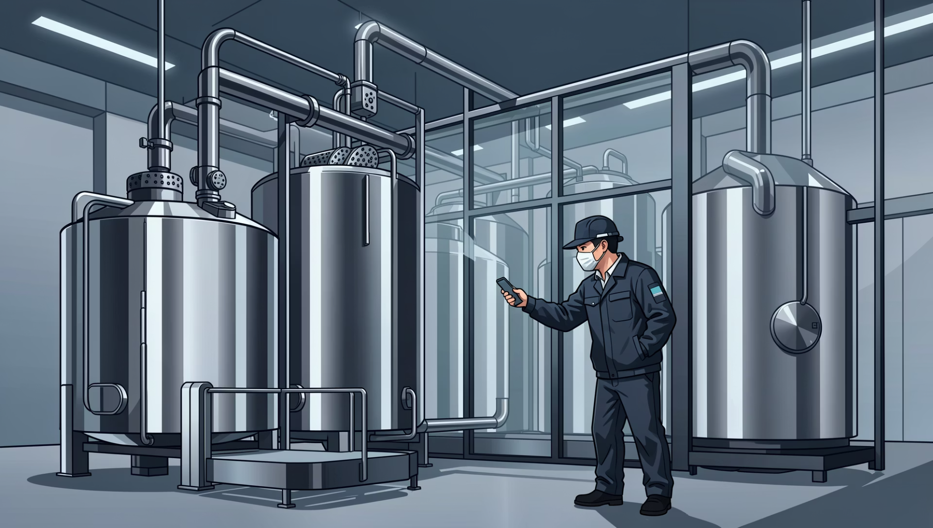
CIP & Borewell — Diagnostics and Filters
Smart Water Potability Prediction & Filtration Solutions
CIP Water (18% potable)
Primary concerns: organics, particulates, microbial load. Recommended train: MMF (10–20 μm) → Activated Carbon (organics/chlorine) → Cartridge (1–5 μm).
Borewell Water (25% potable)
Typical challenges: sand, iron, high TDS. Recommended train: Hydrocyclone (>50 μm) → MMF (10–20 μm) → Iron removal (if needed) → Cartridge (5 μm) → RO/softener for critical uses.

Slide 28
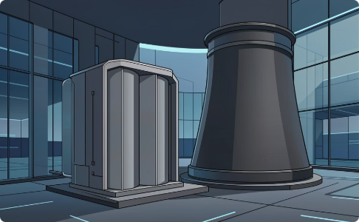
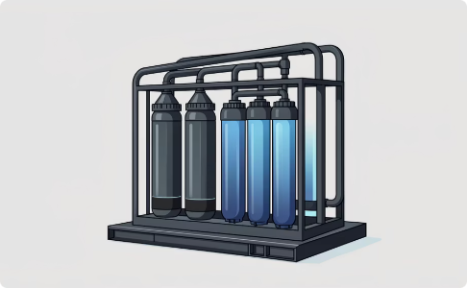
Cooling Tower & Process Water — Protection from Scaling and Contamination
Smart Water Potability Prediction & Filtration Solutions
Cooling Tower
Process Water
Sand/MMF (20–40 μm) + side‑stream filtration (continuous) ± cartridge (10 μm). Add UV or biocide dosing based on microbial risk.
MMF (10–20 μm) → Activated Carbon → Cartridge (1–5 μm). Controls focused on product quality and equipment protection.
Benefits: improved heat transfer, reduced downtime, consistent product specifications.

Slide 29
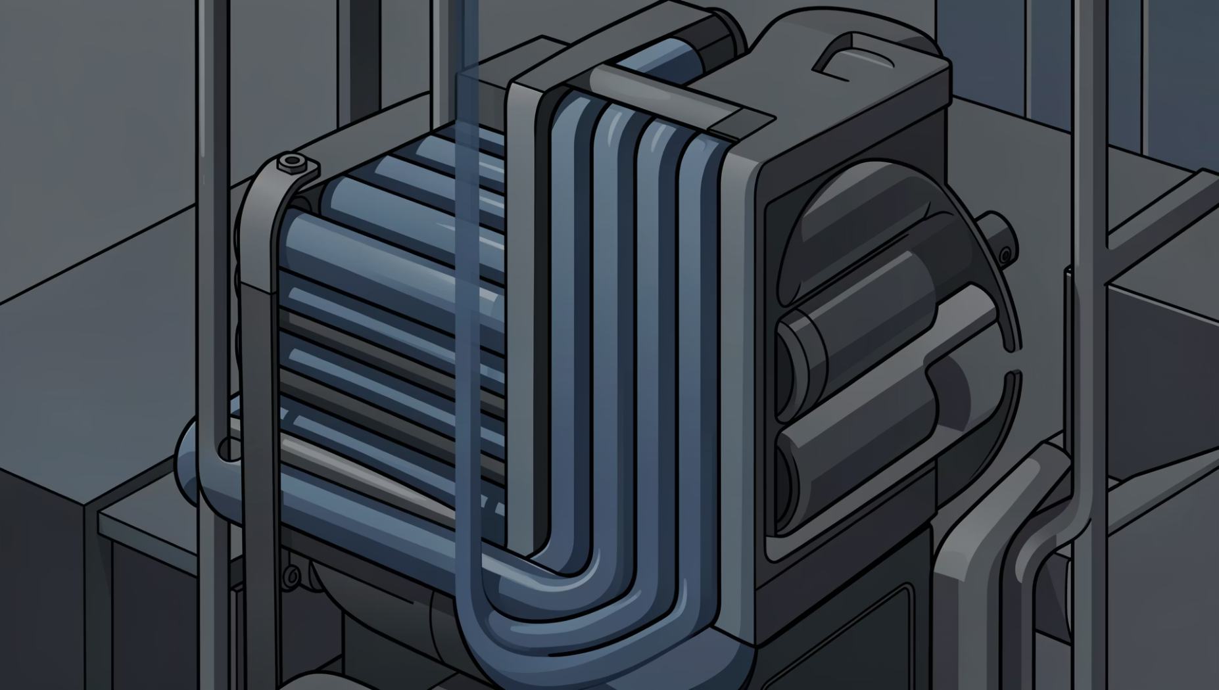
Chiller & Municipal Supply — Practical Filtration Mix
Smart Water Potability Prediction & Filtration Solutions
Chiller Water
Prevent exchanger blockage: Y‑strainer/basket (100–500 μm) → side stream filter (10–20 μm). Focus on particulate removal to preserve heat transfer.
Municipal Supply
Common issues: residual chlorine, suspended solids. Suggested train: MMF (10–20 μm) → Activated Carbon → Cartridge (5 μm). Consider pH stabilization where required.

Slide 30
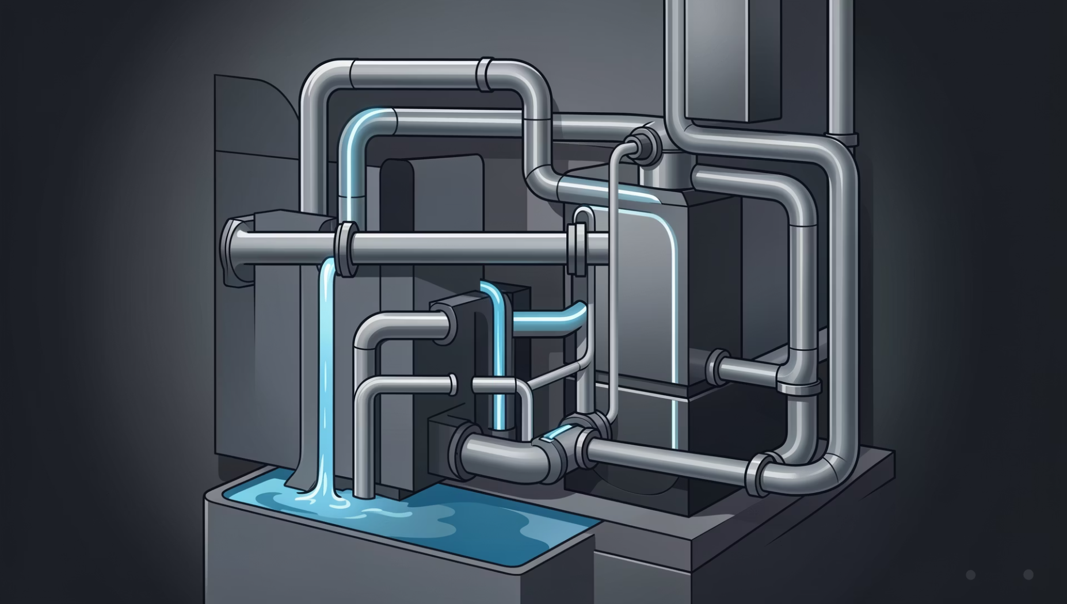
High‑Quality Streams — Steam Condensate & RO Treated Water
Smart Water Potability Prediction & Filtration Solutions
Steam Condensate (95% potable)
Recommended: bag/cartridge filters (1–5 μm); oil removal if carryover present. Goal: protect boiler and prevent carryover contaminants.
RO Treated Water (92% potable)
High‑purity uses: cartridge (0.2–1 μm) and optional UV sterilization for microbial control. Monitor conductivity and TOC for process criticality.

Slide 31
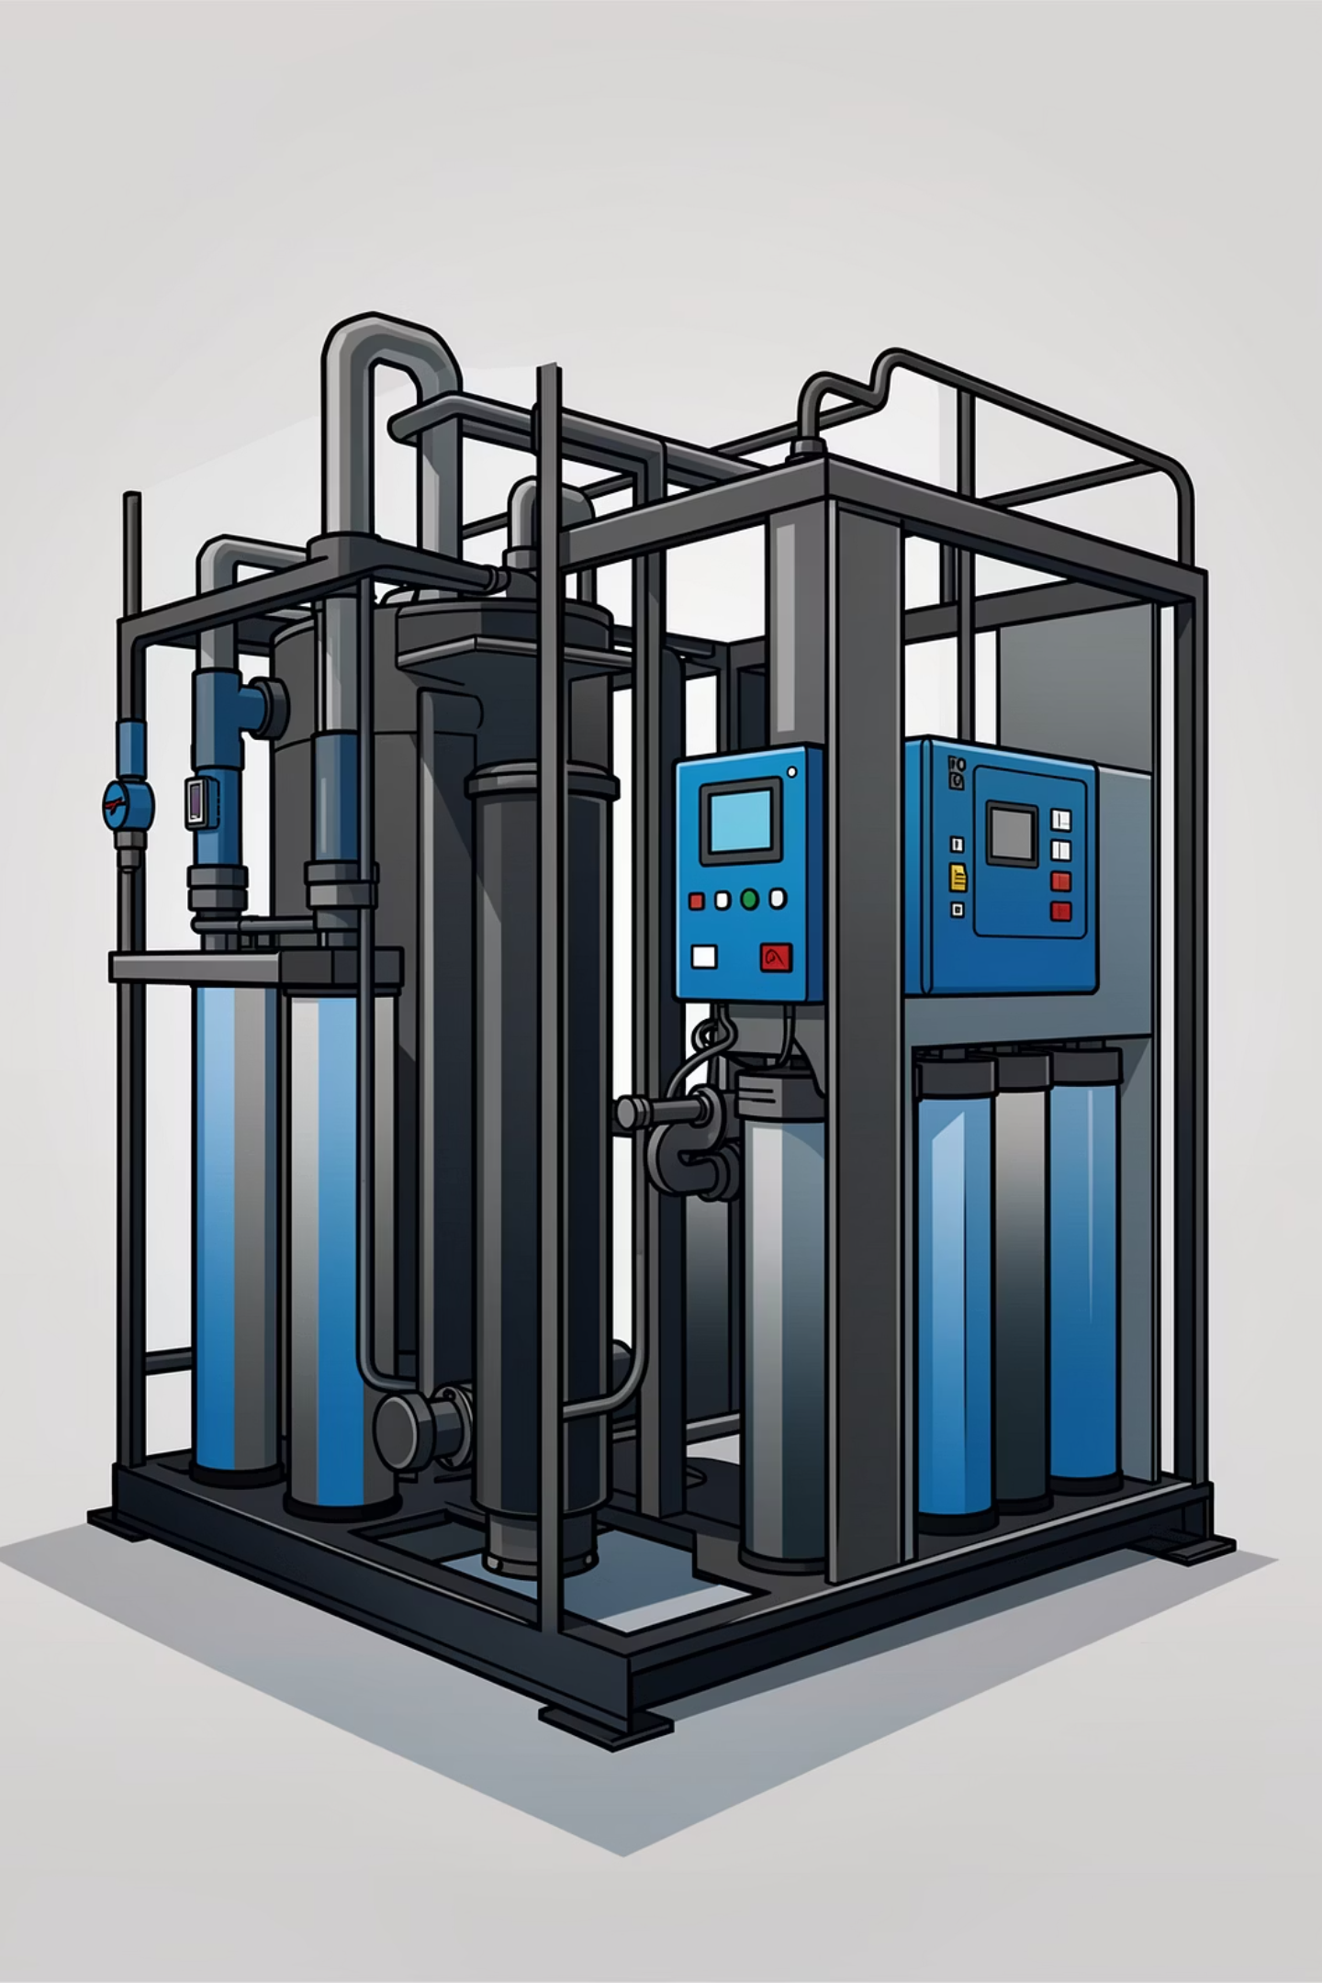
Boiler Feed & Final Rinse — Critical Controls
Smart Water Potability Prediction & Filtration Solutions
Boiler Feed Water
Multimedia (10 μm) → Cartridge (1–5 μm) → RO if required. Objectives: minimize scaling, protect metallurgy, extend boiler life.
Final Rinse (Product Contact)
Cartridge (0.2–0.5 μm) + UV sterilizer for microbial removal. Ensure validation protocols and routine integrity checks.
Next steps: deploy AquaSafe AI scoring on sample streams, implement prioritized filtration trains for highest‑risk sources, and establish monitoring + retraining cadence for continuous improvement.

Slide 32

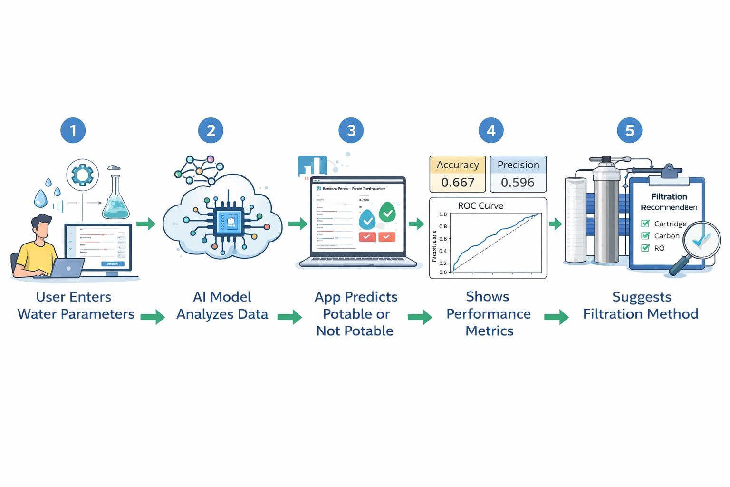
Streamlit Deployment
AquaSafe AI
Overall Working Flow
Step 1: User enters water parameters
Step 2: AI model analyses data
Step 3: App predicts potable or not potable
Step 4: Shows performance metrics
Step 5: Suggests filtration method
“This Streamlit app uses machine learning to analyze water quality parameters and predict whether water is safe for consumption, while also providing performance metrics and filtration recommendations”

Slide 33
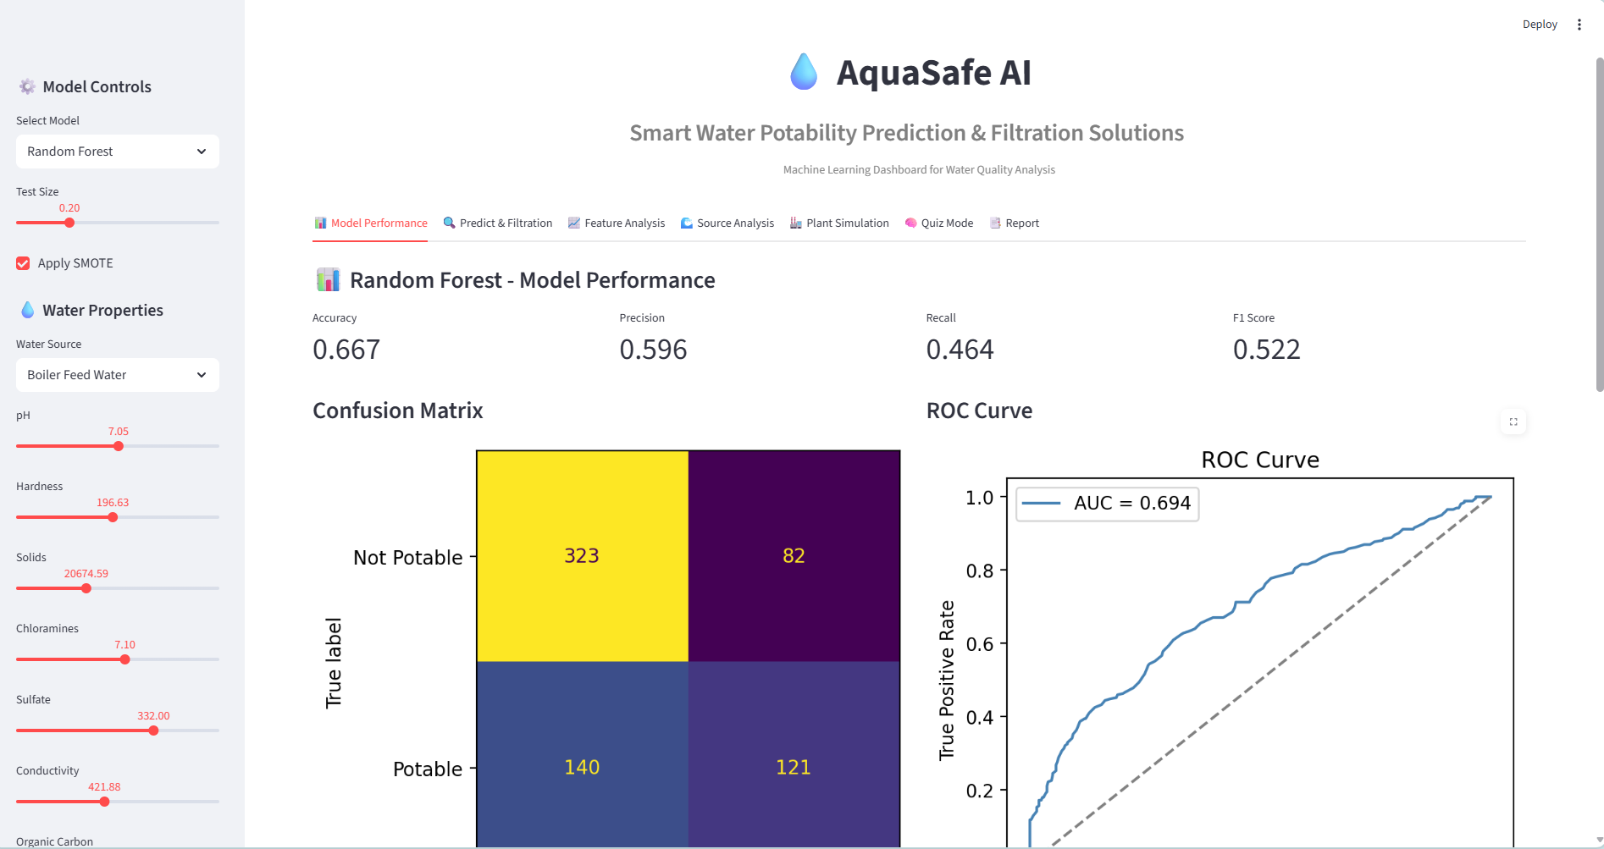
Streamlit Deployment
AQUASAFE AI
App Features
Live parameter input
Potability prediction
Filtration suggestion
Risk alerts
Trend Charts

Slide 34
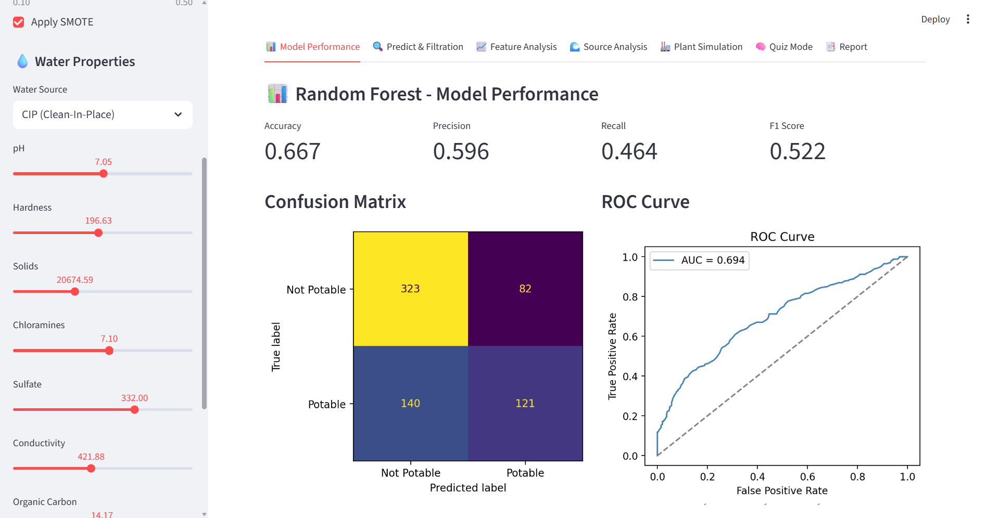
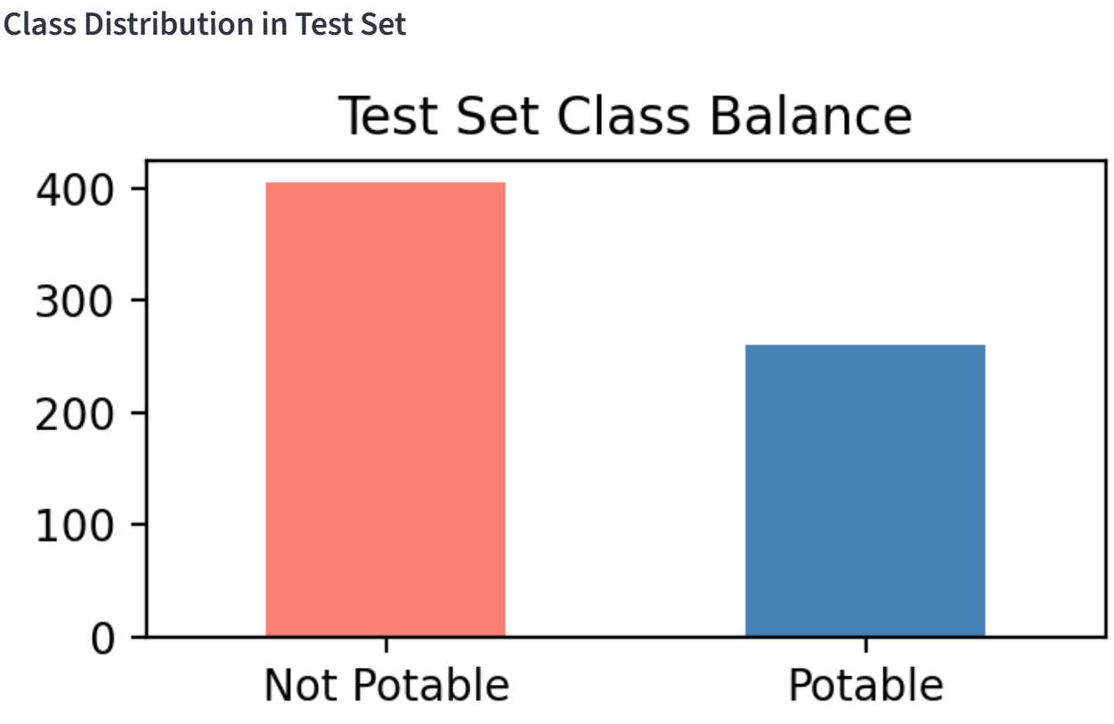
Model Performance
Predict whether water is Potable (Safe) or Not Potable (Unsafe)
Show model performance
Recommend filtration methods
Help plant operators or engineers make decisions
Test Size (0.20)This means:80% data → used for training the model20% data → used for testing the modelTesting checks how well the model performs on new data.
323 → correctly identified unsafe water ✅
121 → correctly identified safe water ✅
82 → unsafe water predicted as safe ❌
140 → safe water predicted as unsafe ❌
ROC Curve-In machine learning, the ROC curve is used to evaluate how well a classification model performs by plotting:
AUC = 0.694Meaning:0.5 → bad model0.7 → good model1.0 → perfect modelYour model = good performance.
Confusion Matrix (Very Important)
This table shows prediction results.

Slide 35
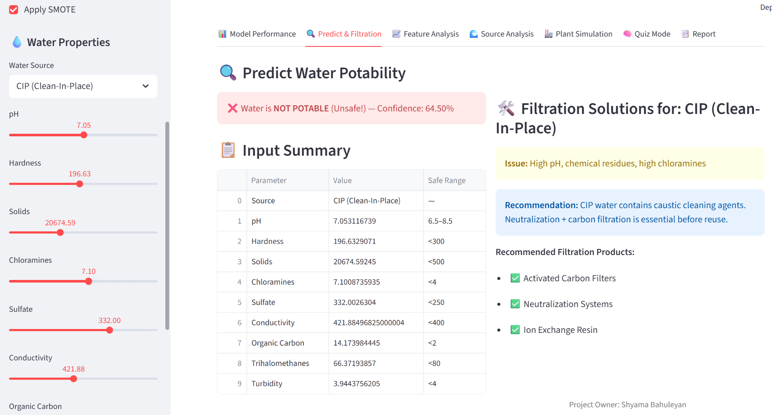
Predict & Filtration
Interactive prediction: User enters water properties (pH, hardness, etc.)
Output: Potable or Not Potable with confidence score
Filtration solutions: Recommended treatment methods for each source
Visual: Input summary table + filtration guide

Slide 36
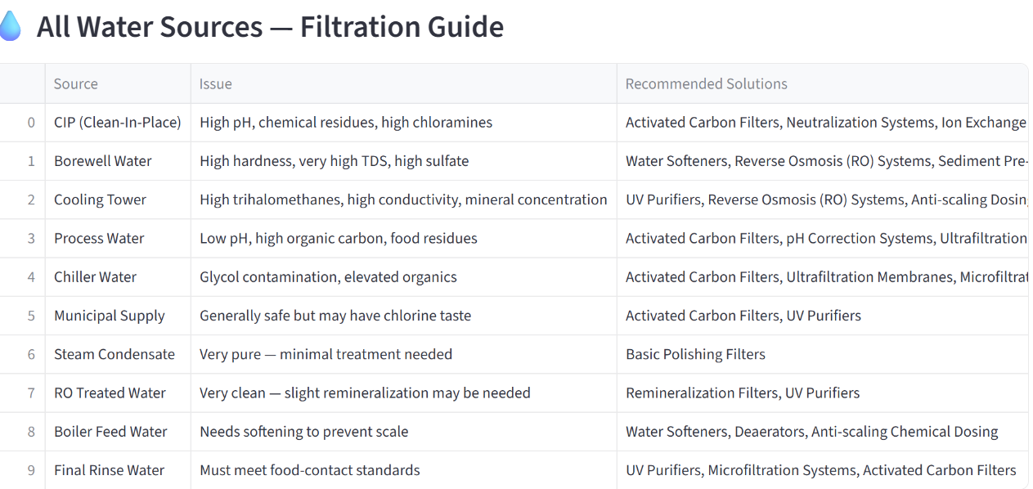
Filtration Guide Generation from Dataset
How Filtration Recommendations Are Generated
Input Data:
Water quality parameters (pH, TDS, Turbidity, Hardness, Organics, Chlorine)
Water source type (CIP, Borewell, Cooling Tower, Process Water)
Method Used: Rule-Based Decision Logic
Parameter thresholds defined using water standards
Each exceeded parameter mapped to a treatment method
Examples:
High TDS → Reverse Osmosis (RO)
High Hardness → Water Softener
High Turbidity → Sediment Filter
High Organics/Chlorine → Activated Carbon
Microbial risk → UV Purifier
Output: ➡️ Automatic filtration solution recommendation table ➡️ Source-wise treatment guide ➡️ Industry-ready decision support
From the dataset, we used key water quality parameters like pH, TDS, turbidity, and hardness. We defined threshold limits based on standard water treatment guidelines. Then we applied rule-based logic that maps each parameter exceedance to a suitable filtration technology. For example, high TDS triggers RO recommendation, high hardness suggests softeners, and high turbidity suggests sediment filters. This converts raw sensor data into an automatic filtration guide for each water source, making the system practical for real industrial use.”

Slide 37
“AquaSafe AI”-Smart Water Potability Prediction & Filtration Solutions
Filtration Guide Generation from Dataset
How Filtration Recommendations Are Generated
Input Data:
Water quality parameters (pH, TDS, Turbidity, Hardness, Organics, Chlorine)
Water source type (CIP, Borewell, Cooling Tower, Process Water)
Method Used: Rule-Based Decision Logic
Parameter thresholds defined using water standards
Each exceeded parameter mapped to a treatment method
Examples:
High TDS → Reverse Osmosis (RO)
High Hardness → Water Softener
High Turbidity → Sediment Filter
High Organics/Chlorine → Activated Carbon
Microbial risk → UV Purifier
Output: ➡️ Automatic filtration solution recommendation table ➡️ Source-wise treatment guide ➡️ Industry-ready decision support

Slide 38
“AquaSafe AI”-Smart Water Potability Prediction & Filtration Solutions
Filtration Guide Generation from Dataset
From the dataset, we used key water quality parameters like pH, TDS, turbidity, and hardness. We defined threshold limits based on standard water treatment guidelines. Then we applied rule-based logic that maps each parameter exceedance to a suitable filtration technology. For example, high TDS triggers RO recommendation, high hardness suggests softeners, and high turbidity suggests sediment filters. This converts raw sensor data into an automatic filtration guide for each water source, making the system practical for real industrial use.”

Slide 39
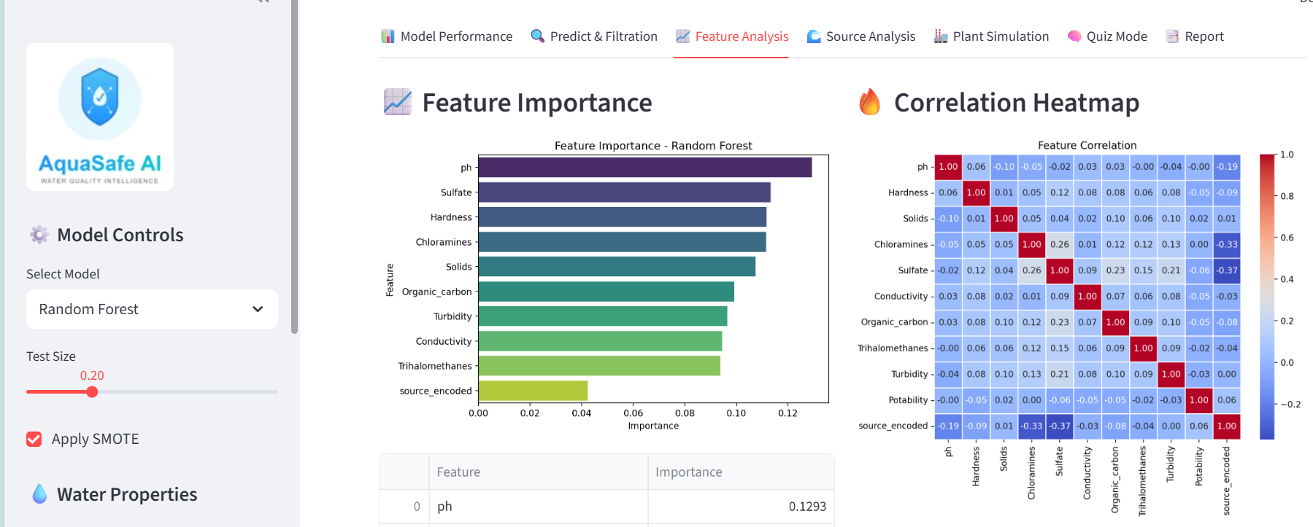
Feature Analysis
Feature Importance
This chart shows which water quality parameters are most important for predicting water potability using the Random Forest model.
What "Feature Importance" means?
Feature importance tells us which factors influence the model decision the most.
Higher value = more important feature
Lower value = less important feature
Chemical parameters like pH, sulfate, and hardness play the biggest role in determining water quality.
“This feature importance chart shows which water quality parameters have the greatest impact on our model’s prediction. The most important feature is pH, meaning it strongly influences whether water is potable or not. Other important features include sulfate, hardness, and chloramines. Parameters like turbidity and conductivity have moderate influence, while source type has the least impact. This helps us understand which water quality factors are most critical for monitoring and treatment.”
Feature Importance: Bar chart showing which parameters most influence potability
Correlation Heatmap: Relationships between water properties
Partial Dependence Plot: How one feature affects predictions
Distribution Plots: Compare feature values for potable vs non-potable water

Slide 40
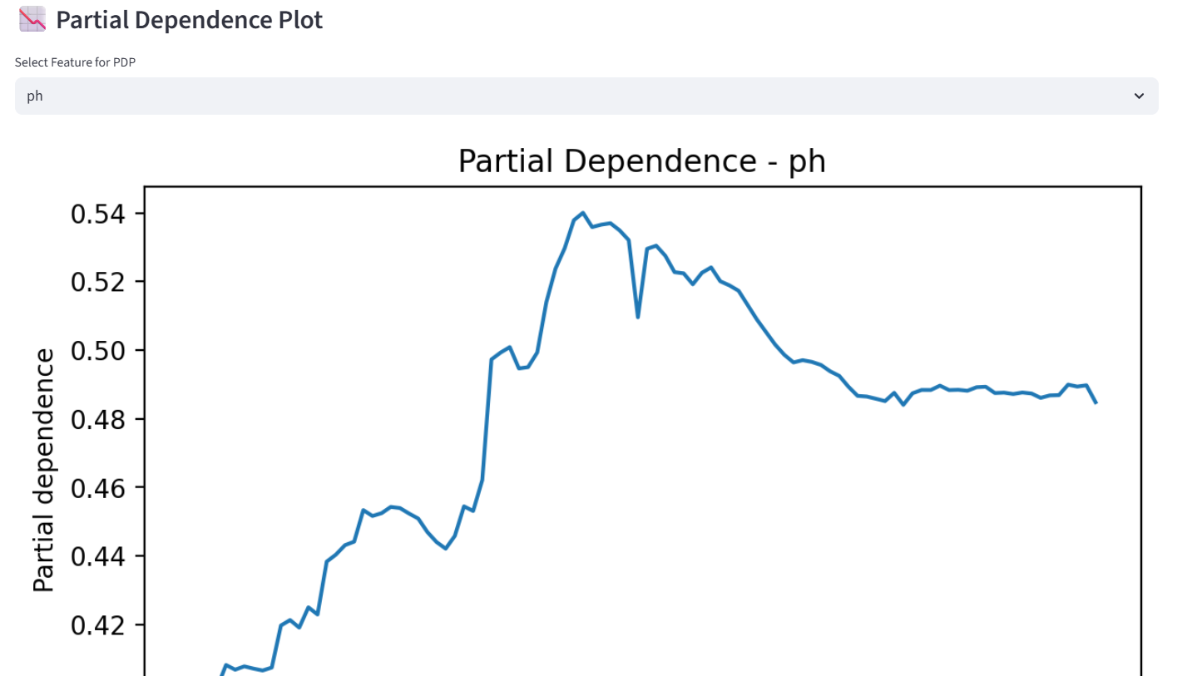
Partial Dependence
What this graph tells us
When pH increases from low to normal range, the probability of potable water increases
The model shows highest probability around neutral pH (around 7–8)When pH becomes too high, the probability slightly decreases
🔹 Key Insight
➡️ Water is most likely to be potable when pH is in the normal/neutral range
➡️ Very low or very high pH reduces water quality
“Partial dependence plot shows how a single feature, like pH, affects the model prediction while keeping other features constant.”
“This partial dependence plot shows how pH affects water potability prediction. The X-axis shows pH values and the Y-axis shows the predicted probability of potable water. We can see that as pH increases to a normal range, the probability of potable water increases. However, extremely high or low pH reduces potability. This confirms that maintaining balanced pH is important for safe drinking water.”

Slide 41
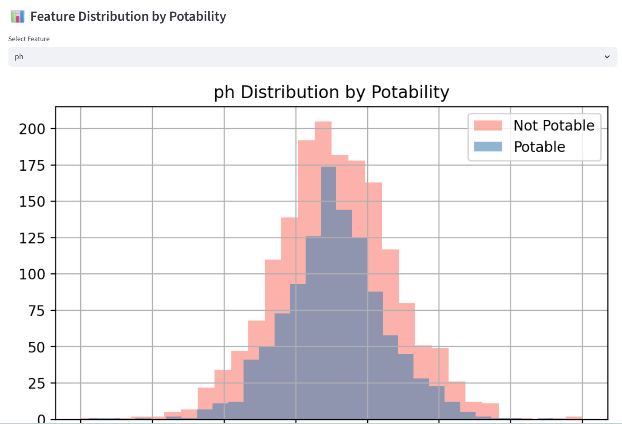
Feature Distribution
This graph shows how pH values are distributed for potable and non-potable water.
Explanation
Most water samples have pH between 6 and 8
Potable water is mostly in the normal pH range
Not potable water is more spread out, including extreme pH values
There is some overlap, meaning pH alone is not enough — other features also matter
Key Insight
➡️ Safe drinking water usually has balanced pH (around neutral range)
➡️ Extreme pH values increase the chance of water being unsafe
“This plot compares the distribution of pH values between potable and non-potable water samples.”
“This graph shows the distribution of pH values for potable and non-potable water. The blue color represents potable water and red represents non-potable water. We can see that most potable water samples fall within the normal pH range of around 6 to 8. Non-potable water has more extreme pH values. This shows that pH is an important factor in determining water quality, but other parameters also influence potability.”

Slide 42
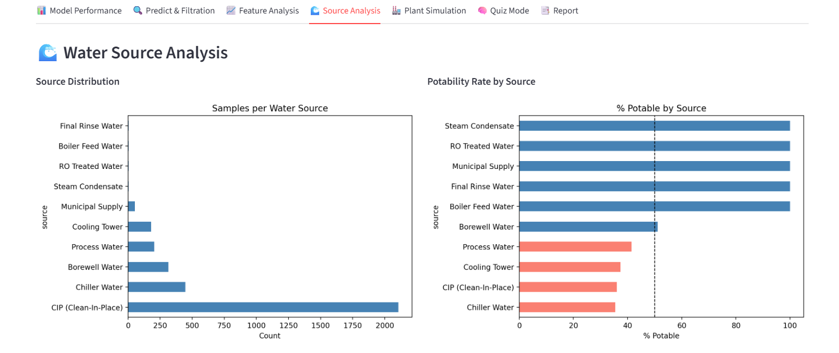
Source Analysis
This dashboard shows how water quality varies across different sources
Samples per Water Source
Key observations:
CIP (Clean-In-Place) has the highest number of samples
Chiller water and Borewell water also have good sample counts
Some sources like Municipal supply and Steam condensate have fewer samples
Insight:➡️ This helps us understand which sources contribute most to the dataset
Potability Rate by Source
This chart shows percentage of potable water from each source.
Key Insights
➡️ Treated water sources like RO and municipal supply are safest
➡️ Industrial sources like cooling tower and process water need more filtration
“This dashboard shows water source analysis. The left chart shows the number of samples collected from each source, with CIP water having the highest number of samples. The right chart shows the percentage of potable water by source. We can see that treated sources like RO water, municipal supply, and steam condensate have the highest potability rate. Industrial sources like cooling tower, process water, and chiller water have lower potability rates, indicating they require additional treatment. This analysis helps identify which sources are safe and which need filtration.”

Slide 43
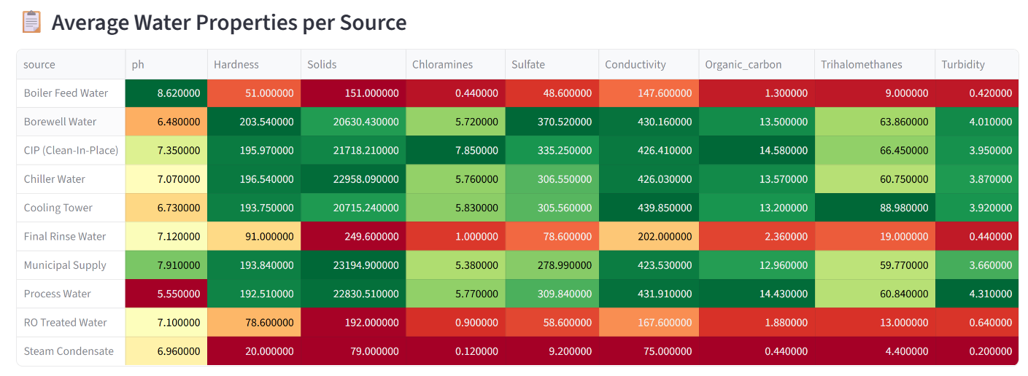
Source Analysis
This table shows the average values of water quality parameters for each water source.
Each row = one water source Each column = one water quality parameter
The colors help identify quality:
🟢 Green → Good / safe range
🟡 Yellow → Moderate
🔴 Red → Poor / unsafe range
Key Insights from the Table
Best quality sources (mostly green):
Steam Condensate
RO Treated Water
Final Rinse Water
Municipal Supply
These have:Low solids
Low turbidity
Low harmful chemicals
“This table shows the average water quality parameters for each water source. Green color indicates safe values, while red indicates unsafe levels. We can see that treated sources like steam condensate, RO water, and municipal supply have better quality with low impurities. Industrial sources like process water, cooling tower, and chiller water show higher solids and conductivity, indicating lower quality. This analysis helps identify which sources require additional filtration.”
“This table shows the average water quality parameters for each source, helping identify safe and unsafe water sources.”

Slide 44
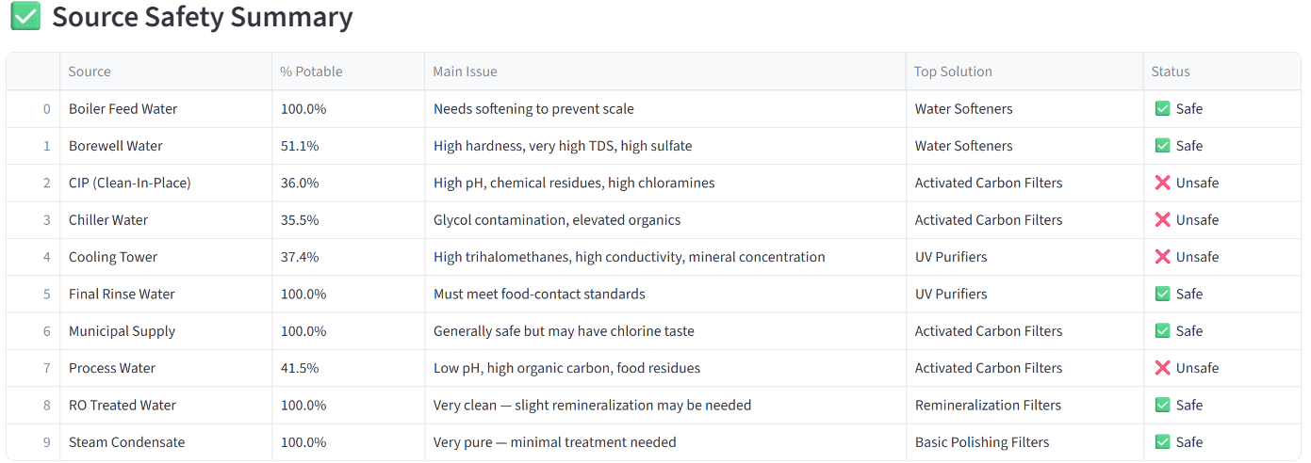
Source Analysis
Recommended Solutions
Different filtration methods are suggested:
Water Softeners → Remove hardness
Activated Carbon Filters → Remove chemicals and organics
UV Purifiers → Kill bacteria and microorganisms
Remineralization Filters → Add essential minerals
Basic Filters → Final purification
Key Conclusion
➡️ Treated water sources are safe
➡️ Industrial water sources need filtration
➡️ The model helps recommend correct filtration method
“This table shows the safety summary of different water sources. It includes the percentage of potable water, main quality issues, and recommended filtration solutions. Sources like RO treated water, municipal supply, and steam condensate are safe with high potability. Industrial sources like cooling tower, chiller water, and process water are unsafe due to impurities and require filtration methods like activated carbon filters and UV purifiers. This helps identify safe sources and recommend proper treatment.”

Slide 45
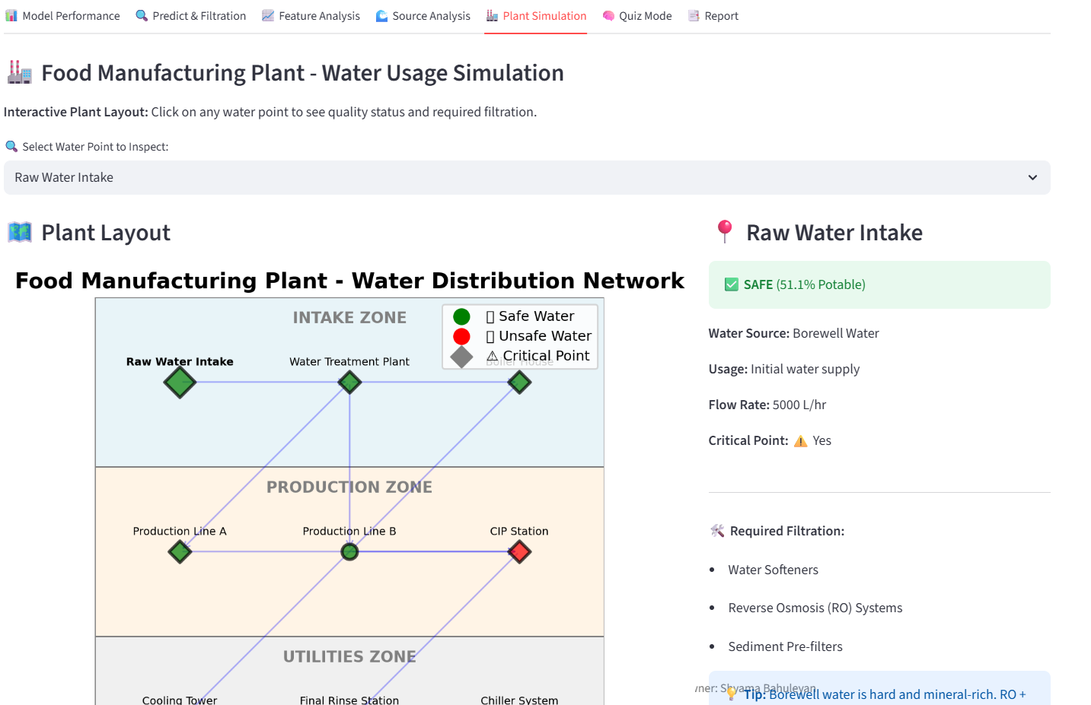
Plant Simulation-Food Manufacturing Plant
Why this simulation is useful
It helps to:
Identify unsafe water points
Suggest filtration methods
Monitor plant water quality
Improve safety in food production
This screen shows how water flows through different parts of the plant and whether it is safe or unsafe.
“This simulation shows water flow, safety status, and required filtration at different plant locations.”

Slide 46
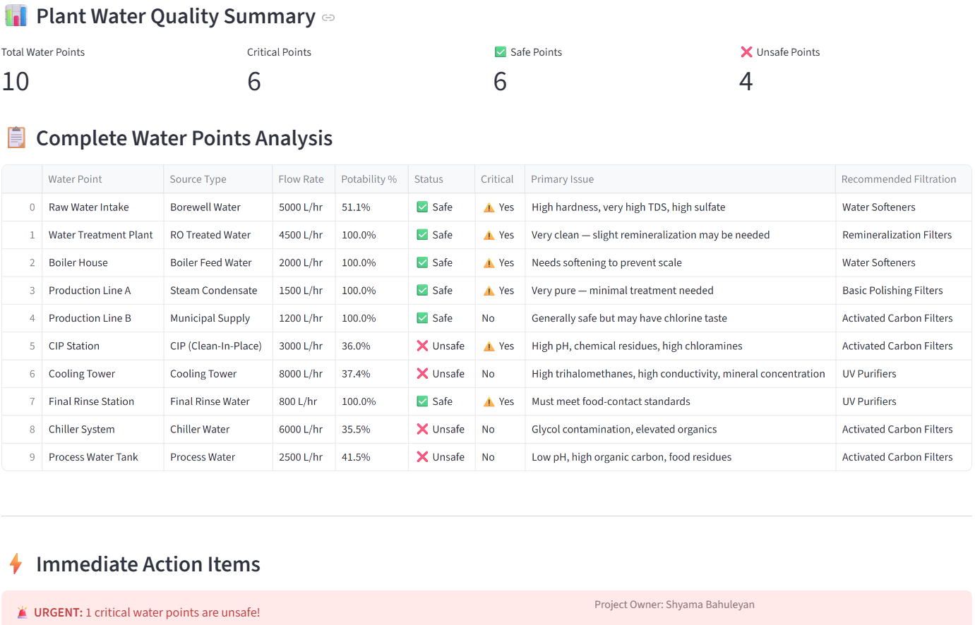
Plant Simulation-Food Manufacturing Plant
“This screen shows the complete water quality summary of the plant. There are 10 water points, out of which 6 are safe and 4 are unsafe. The table provides detailed information such as water source, flow rate, potability percentage, and recommended filtration methods. Unsafe points like CIP station and cooling tower require treatment such as activated carbon filters and UV purifiers. This analysis helps identify critical points and ensures safe water usage in food manufacturing.”

Slide 47
Plant Simulation-Food Manufacturing Plant
Conclusion
Key Takeaway: Dashboard integrates ML predictions, interpretability, and practical filtration solutions
Impact: Helps stakeholders quickly assess water safety and take corrective action
Future Work: Retraining with new data, integrating lab testing, expanding to more industries

Slide 48
“AquaSafe AI
7 Interactive Tabs:
1️⃣ Model Performance - Confusion matrix, ROC curve
2️⃣ Prediction & Filtration - Real-time water quality check
3️⃣ Feature Analysis - Importance & correlations
4️⃣ Source Analysis - Safety rankings & stats
5️⃣ Plant Simulation - 10-point water distribution map
6️⃣ Quiz Mode - Training tool for operators
7️⃣ Reports - Downloadable Excel/PDF reports
🎯 User-friendly interface for plant operators
📱 AquaSafe AI Dashboard (Streamlit)

Slide 49
“AquaSafe AI
💡 Key Findings
1️⃣ Random Forest achieves 67% accuracy (best model)
2️⃣ pH and Hardness are most critical parameters
3️⃣ 5 out of 10 water sources need immediate filtration
4️⃣ CIP and Borewell water pose highest contamination risk
5️⃣ Real-time prediction reduces testing time from 24hrs → instant
6️⃣ Model explains its decisions (SHAP) for regulatory compliance

Slide 50
“AquaSafe AI
📋 Business Recommendations
Immediate Actions (Week 1-2):
Install RO systems for Borewell & Cooling Tower
Implement pH monitoring at all critical points
Short-term (Month 1-3):
Deploy AquaSafe AI dashboard plant-wide
Train operators on quiz mode
Long-term (Quarter 1-2):
Integrate IoT sensors for real-time data feed
Expand to other manufacturing facilities
Compliance:
Retrain model quarterly with new lab data

Slide 51
“AquaSafe AI”
🚀 Future Enhancements
📡 IoT Sensor Integration
→ Real-time automated water quality monitoring
🔧 Predictive Maintenance
→ Forecast when filtration systems need servicing
📱 Mobile App
→ Alerts & notifications for plant managers
🏭 Multi-Plant Deployment
→ Centralized monitoring across facilities
🤖 AutoML
→ Automatic model retraining & optimization

Slide 52
“AquaSafe AI”
Result & Impact
Live Parameter Input
Reduce contamination risk
Optimized filtration cost
Better Compliance
Stakeholder Impact
Easy-to-read dashboards
Actionable recommendations for filtration/machinery
Builds trust and transparency
Conclusion
“AquaSafe AI” improves water safety prediction
Supports decision-making in food manufacturing

Slide 53
Stakeholder Report
Feature Importance

Slide 54
Questions ?

Slide 55
Thank You!

